Slide 1
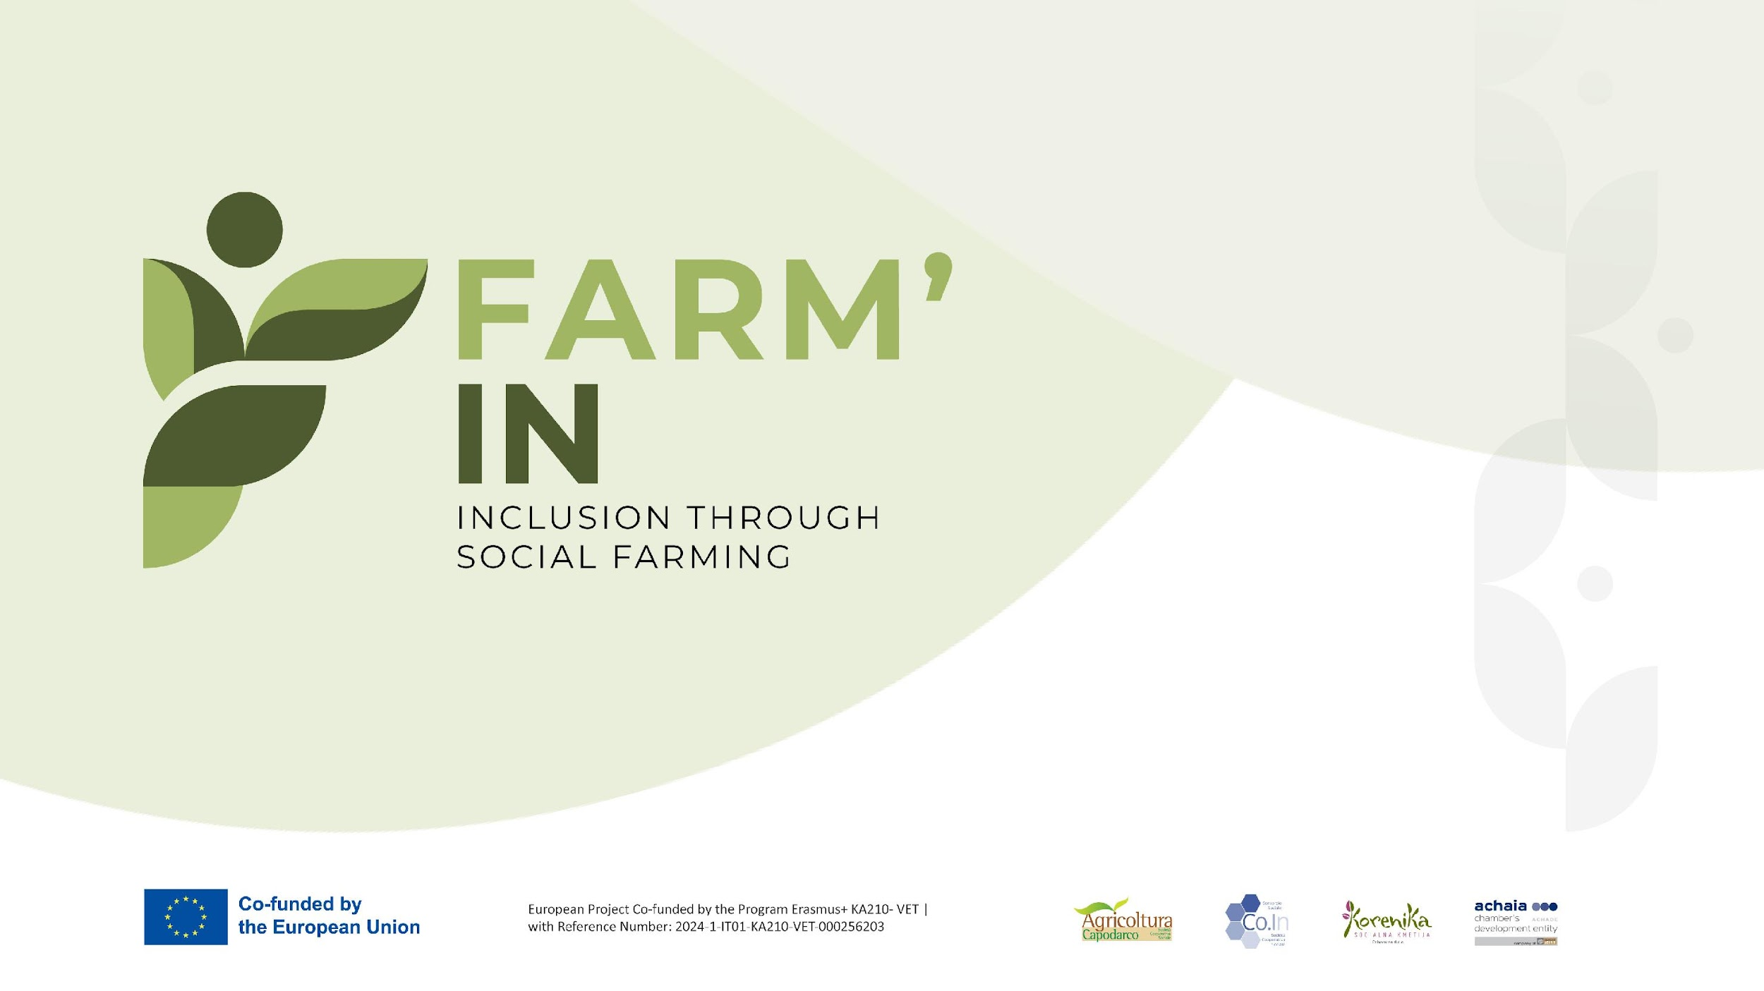

Slide 2

Introduction to Social Farming:
Definition and history of social farming

Slide 3
What is Social Farming?
There is no univocal definition of Social Farming in Europe, although scientific literature has extrapolated the characterizing elements from the set of practices adopted
Social Farming (SF) is both a traditional and innovative use of agriculture. It includes all activities that use agricultural resources, both from plants and animals, in order to promote (or to generate) therapy, rehabilitation, social inclusion, education and social services in rural areas. (Di Iacovo, O’Connor, 2009)
Those activities in which a social purpose is intentionally pursued and assumed as the outcome of an agricultural practice (Senni, 2010).

Slide 4
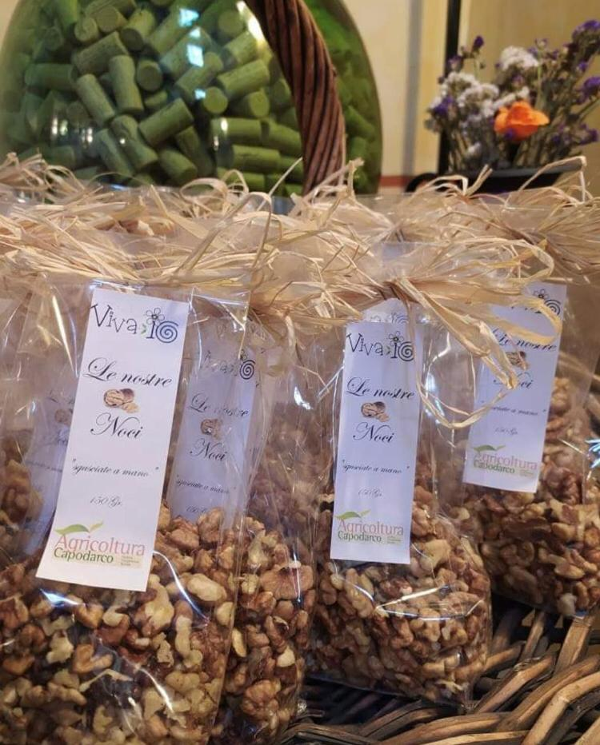
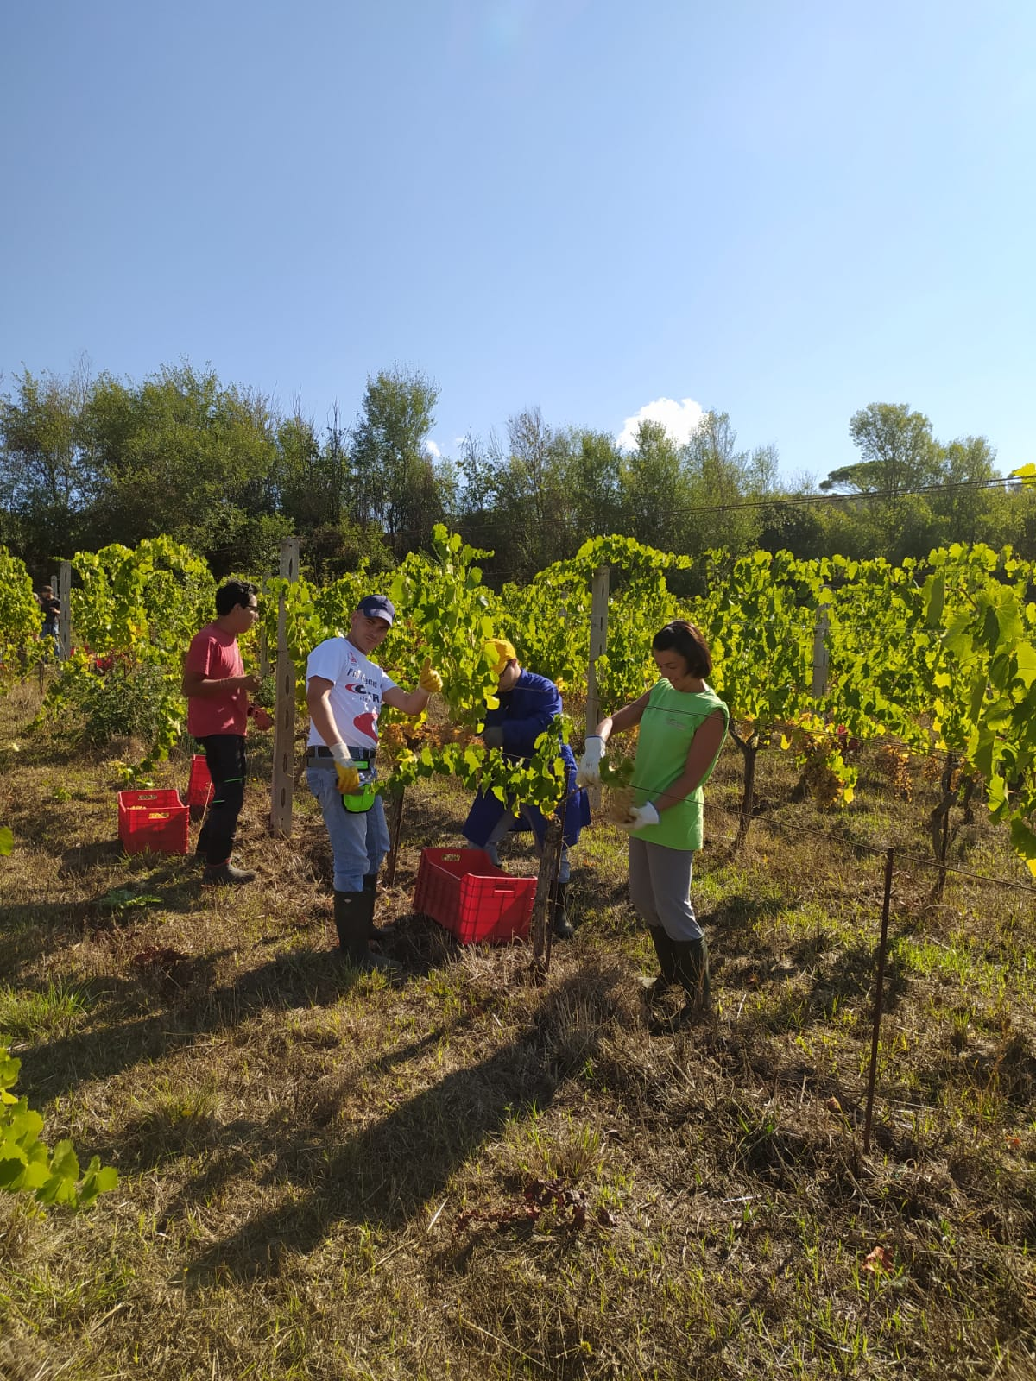
It is one of the practices of agriculture multifunctionality and diversification (…) it is a specific form of co-production of personal services, where agriculture’s non specialistic resources are used to organize innovative personal services (Di Iacovo, 2013).
Social farming is an innovative approach that brings together two concepts: multipurpose farming and social services/health care at local level. It makes a contribution in the ambit of agricultural production to the well-being and the social integration of people with particular needs. (…) The purpose of social farming is among other things, to create conditions within a farm that allow people with specific needs to participate in the daily activities of a farm, in order to ensure their development and individual fulfillment, contributing to improving their well-being. (European Economic and Social Committee, 2013)

Slide 5
Social Farming Practices
Social Farming includes a plurality of experiences that cannot be traced back to a single model, in terms of the type of organization, activity carried out, recipients, sources of funding, but which have in common the characteristic of integrating socio-health, educational, training and job placement, and recreational activities into agricultural activity, aimed in particular at disadvantaged population groups or those at risk of marginalization.
Being part of multifunctional farming, social farming can offer a wide range of services aimed at pursuing the well-being of all citizens and therefore respond to a wider need for welfare policies.
The common element remains agriculture as a tool for offering services to society and care and rehabilitation activities

Slide 6
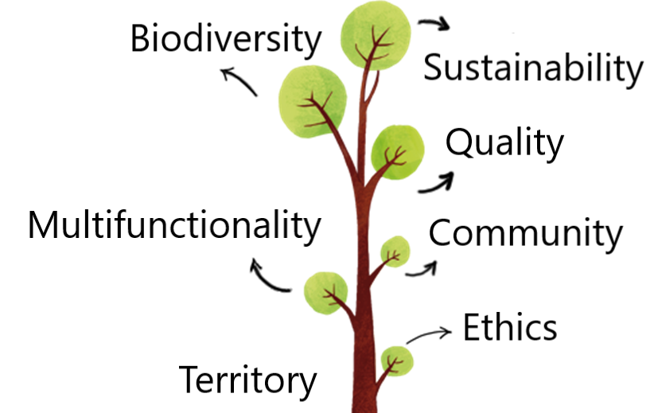

Slide 7
Social Farming Addressees
Starting from the various Social Farming experiences existing in Europe, it is possible to identify some very specific groups to whom social farming activities are addressed:
  People with mental health problems
  People with cognitive and/or physical disabilities
  People at risk of social marginalization (e.g. youth at risk)
  People with a history of pathological addictions (alcohol, drugs)
  Refugees
  Lonely elderly people
  Children (in the specific case of agri-nursery and agri-kindergarten)
Given the highly innovative nature of social farming, the types of people it addresses change according to the needs of society and territorial contexts, proving to be a broad response for different types of so-called at-risk categories.
The Focus Group on Social Agriculture, in trying to define the scope of intervention, actually used a broad spectrum of areas concerning health, social services, education, social inclusion, rehabilitation.

Slide 8
Social farming definition in Italy
Italy, unlike Greece and Slovenia, has a specific legislation on Social Farming
Social Farming is regulated by Law 141/2015 “Provisions on the matter of Social Agriculture” which first of all contains a relatively complete definition of this practice, having included as much as possible all the different declinations of Social Farming from the 1970s onwards.

Slide 9
Law 141/2015 – Provisions on the matter of Social Agriculture
The Law specifies that Social Farming includes activities carried out by agricultural entrepreneurs […], individually or in association, and by social cooperatives […] aimed at achieving:
Social and working inclusion of disadvantaged, severely disadvantaged people and people with disabilities…and minors of working age included in rehabilitation and social support projects;
Social and services provisions and activities for local communities through the use of agricultural tangible and intangible resources to promote, support, and implement actions aimed at developing skills and abilities, social and occupational inclusion, recreation, and useful services for daily life;
Services and provisions complementing and supporting medical, psychological, and rehabilitative therapies, aimed at improving the health and social, emotional, and cognitive functioning of affected individuals, including through the use of farmed animals and plant cultivation;
Projects aimed at environmental and nutritional education, biodiversity protection as well as at the promotion of territories.

Slide 10
Social farming history
The historical framework of Social farming is rather problematic
Trying to trace the origins of this practice, there have also been those who have argued that in a certain way agriculture has always been the sector responsible for the inclusion of different social needs: the traditional pre-industrialized peasant family was the social model responsible for taking care of the community and its problems.
According to this vision, all the farming activities have a deep social nature regardless of intentions
In this sense it is often argued that Agriculture is Social

Slide 11
Social Farming history – The 18th and 19th centuries experiences
In the experiences traced historically between the 18th and 19th centuries, it should be noted that those who practiced agriculture did not intend for therapeutic purposes.
At the turn of the century, agricultural practices began to flourish, often linked to psychiatric facilities, where psychiatric patients or simply indigent people found employment.
Among the most significant experiences are those of Gheel in Belgium, Clermont-Ferrand in France, and the York Retreat in England.

Slide 12
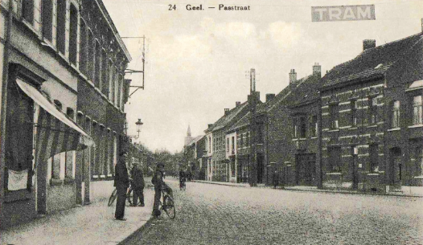
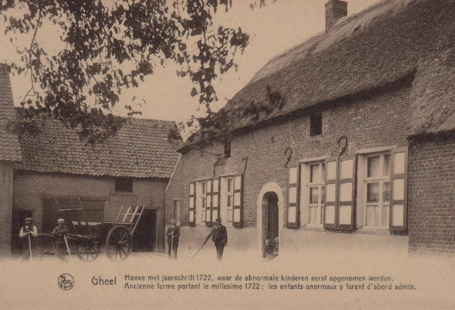
Geel
Geel was a small town near Antwerp. At the beginning of the 19th century, it had about 7,000 inhabitants and was famous because hundreds of people with mental health problems were placed permanently by relatives in the families who lived there.
In the village, there were no suitable shelters, so these people were hosted in numbers of one or two (rarely three or more) in the houses of the village farmers or on farms in the surrounding countryside.
In the Belgian town, “the alienated” simply participated in the life and work of those who hosted them, who “had become familiar with these unfortunates… (had) such a habit that they did not fear even the most furious” and knew how to “lead them like children”.
This kind of social experiment primarily struck doctors and psychiatrists who visited the village: "although free, these patients were never the cause of serious accidents for pregnant women or children.“
Geel hosted a large number of people with mental disabilities: from 400-500 guests in 1821, it increased to around 800 in the middle of the century.

Slide 13
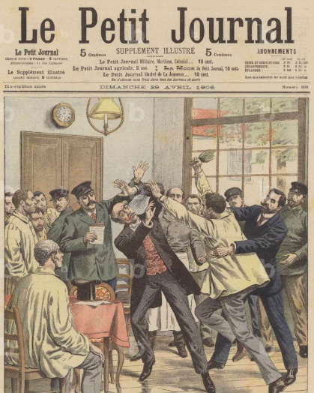
Clermont-Ferrand
The agricultural colony of Clermont-Ferrand, in France’s Massif Central, adopted a different model: a farm detached from but still connected to the psychiatric hospital. Management of the hospital and therefore the associated agricultural activities was not private, but rather public.
People were occupied in the various agricultural tasks in the belief that life and work in the fields represented "one of the most precious means of healing and well-being for the mentally ill".
Agricultural work were functional to the production of goods necessary for the maintenance of the hospital itself
The creation of farms connected to or detached from psychiatric hospitals was considered “a new advance in the fate of the insane” and became quite widespread in Northern Europe.

Slide 14
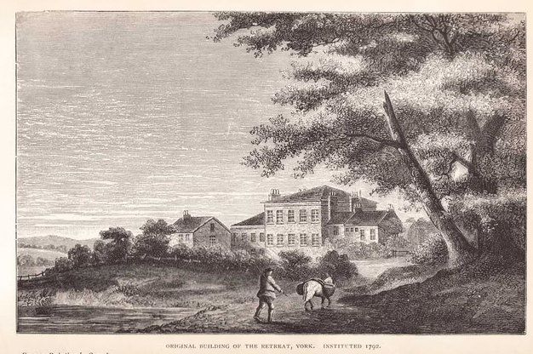
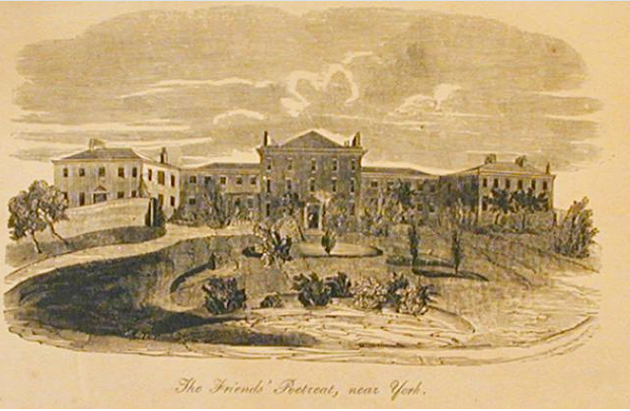
The York Retreat
The York Retreat was founded in 1796 by Samuel Tuke, a member of the Quaker Society, a religious group that since 1649, under the leadership of George Fox, had been concerned with people with mental health problems
The Retreat was a country house where the "alienated" could live in the open air and cultivate vegetable gardens and gardens in contact with the outside world, deriving health benefits from it

Slide 15
Social Farming history – The 19th and 20th centuries experiences
Many monasteries, educational and therapeutic social institutions, and psychiatric hospitals were associated with agricultural facilities used for self-sufficiency in milk, vegetables, meat, eggs, and other foodstuffs.
Healthcare workers were also aware of the benefits agricultural work brought to their patients.
However, in these contexts, cases of child labor exploitation also occurred in orphanages and institutions for young adults, specifically in the agricultural sector.
It remains undoubtedly interesting to understand and trace the history of social farming and, above all, to reconstruct the moment and experiences at which a true understanding of the therapeutic potential of agriculture emerged..
In Europe, social farming is a phenomenon that is still at different stages of development today and much depends on individual national contexts, implemented policies and institutions, as well as, obviously, the different approaches to the topic.

Slide 16
Social Farming history – The ’70s in Italy and the first social agriculture’s experiences
In Italy, Social Agriculture emerged between the late 1970s and early 1980s within the framework of social cooperation with two main objectives: producing goods and services for sale on the market and integrating people with limited employment opportunities into the labor market, particularly those considered disadvantaged (people with disabilities, mental disorders, etc.).
This movement was part of the cultural ferment of the time: it is no coincidence that these were the years of the Basaglia reform (1978), which led to the closure of mental hospitals and the de-institutionalization of people with mental illness.
However, we had to wait until the new millennium for the formalization and conceptualization of this practice, when the Network of Social Farms united in the National Forum of Social Agriculture (2011) brought this phenomenon to the attention of politicians and only in 2015 for its recognition with National Law 141 – thanks to the requests that this organization put forward and to a series of European directives that pushed towards the enactment of national laws in the sector.

Slide 17
Social Farming Models
The Italian model of social farming, precisely because of its bottom-up origins, focuses primarily on an inclusive approach through the social and employment inclusion of disadvantaged people.
In this sense, Italy fits within a "Mediterranean" model that unites it with the experiences of Greece, Spain, and Portugal.
Northern European countries, however, have identified different approaches where social assistance is oriented towards care and assistance, as in the case of the Dutch experience of care farming or care farms in Germany and France, carried out by facilities accredited by the national health system and characterized by a high prevalence of the social and health dimension.

Slide 18
Social Farming Models
MEDITERRANEAN MODEL (Italy, Spain, Portugal, Greece)
Social justice
NORTHERN EUROPEAN MODEL (Netherlands, Austria, Germany, Norway)
Care
Involves the state, civil society, society, and the third sector
Initiatives that originate locally and spread nationally and internationally
A culture of trust, reciprocity, personal commitment, and exchange between initiatives.
Benefits for the agricultural/agri-food sector in terms of visibility, reputation, and added value of the product
Direct intervention and state funding to provide public and healthcare services
Public sector support
Benefits for the agricultural/agri-food sector: direct payments for service professionalization

