Slide 1


Slide 2
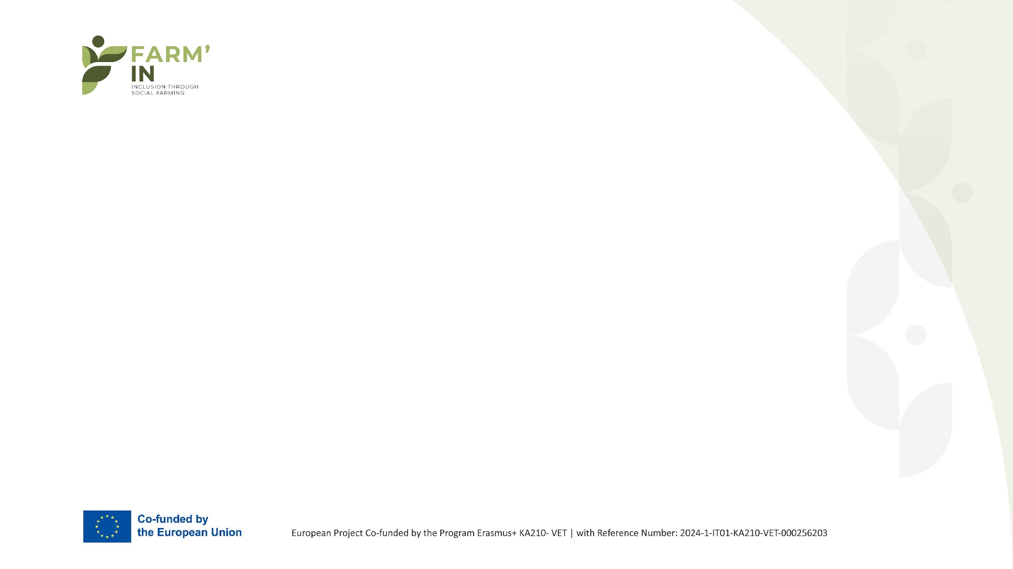
Lesson 1: Creating a Social Farming Business Model

Slide 3
Lesson 1: Creating a Social Farming Business Model
🧩 In-depth & Analytical Approach
Social farming represents an innovative way of linking agricultural production with social inclusion and solidarity. For it to operate effectively and sustainably, a clear, well-structured, and functional business model is required. This model should define "who we are," "who we serve," "what we offer," "how we remain financially viable," and "how we grow."

Slide 4
1.1 What is a Business Model?
It describes how a business creates, delivers, and captures value.
In social farming, the model is hybrid: it combines a social mission with economic operation.
For example, it produces agricultural products while integrating vulnerable groups.

Slide 5
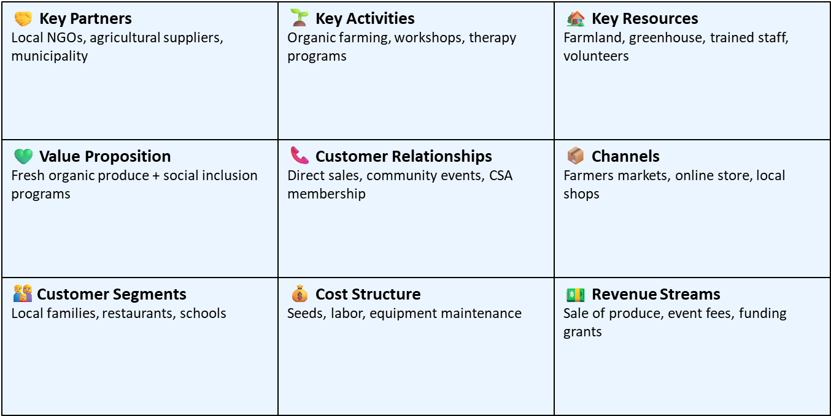
Give me an example of a Business Model
🌾 Business Model Canvas – Social Farm “Green Horizons”

Slide 6
1.2 Value Proposition
The value proposition is the cornerstone of a business. It answers the fundamental question: “Why should someone choose us?”
In social farming, this goes beyond the practical value of a product and includes:
Qualitative value (the product itself: fresh, organic, local, authentic)
Social value (e.g., empowerment and employment of vulnerable groups, combating social exclusion)
Environmental awareness (use of sustainable farming methods, respect for the ecosystem)
Example: Organic products produced by individuals with mental health challenges.
Key Questions: What social change are you aiming for? What emotions do you evoke?

Slide 7
1.3 Customer Segments
A social farming enterprise, unlike a simple production unit, has a diverse audience. The term “customers” refers not only to product consumers but also to social partners and beneficiaries.
Main categories:
Consumers: Individuals or families who purchase products either for their quality or for their social significance (ethical consumption).
Social actors: Municipalities, NGOs, schools, and social services that collaborate with or fund integration or awareness-raising initiatives.
Funders / Investors: Foundations, companies, and philanthropic entities that support the social mission through grants or donations.
Beneficiaries: The individuals who work or participate in the farm. They are both contributors to production and ultimate "customers" of the social value created.

Slide 8
1.4 Revenue Streams
Social Farming is often not financially sustainable through product sales alone. It requires diversified income sources to withstand challenges—economic, social, environmental, or political.
Possible sources of income:
Sales of agricultural products: Direct sales, partnerships with shops, cooperatives, e-shops, subscription-based produce boxes.
Service provision: Educational programs, agritourism experiences, workshops, space rentals.
Donations and sponsorships: From individuals or companies that support social initiatives.
Grants and funding programs: Such as ESF, LEADER, Erasmus+, social economy schemes, innovation, and environmental initiatives.
Challenge: Avoid overdependence on subsidies. Maintaining a balance between stable sources and occasional funding is crucial.
Strategic direction: Develop a “blended economic model” with revenue streams coming from both the market and the social sector.

Slide 9
Practical tools:
1.5 Business Model Canvas (BMC) 1/2
The Business Model Canvas (BMC) is a visual design tool that allows you to view your entire business "on a single page."
It helps connect the different components of the business model and understand how value is created and delivered.
The 9 Building Blocks of the Business Model Canvas (BMC):
Value Proposition – What value you offer
Customer Segments – Who your target audiences are
Channels – How you reach your customers
Customer Relationships – How you maintain and grow customer relationships
Revenue Streams – How your business earns income
Key Activities – What you do daily to keep the business running
Key Resources – Human, physical, and financial resources
Key Partners – The network that supports your mission
Cost Structure – Where and why you spend resources

Slide 10
Practical tools:
1.5 Business Model Canvas (BMC) 2/2
Advantages of the BMC:
Encourages collective thinking and strategic discussion
Suitable tool for newly formed teams or for evaluating existing plans
Provides a clear link between social goals and economic operations
Application in Social Farming:
The BMC can effectively capture the complexity of the initiative. For example:
Key Partners: Municipality, social services, cooperatives, volunteers
Key Activities: Cultivation, training, agritourism, awareness campaigns
Revenue Streams: Product sales, participation in EU-funded programs, supporter subscriptions
Customer Segments: Consumers, schools, families, organizations

Slide 11
Example: Social Farm “Land of Solidarity”
Location: Peloponnese
Model: Social enterprise in organic farming
Goal: Social inclusion of vulnerable groups (unemployed 50+, people with mental health conditions)
Products: Organic vegetables, aromatic herbs
Services: Training, agritourism, collaboration with schools

Slide 12
Business Model Canvas – Land of Solidarity
Value Proposition: Organic products + social inclusion
Customer Segments: Local consumers, schools, tourists
Channels: E-shop, local markets, community events
Customer Relationships: Education, subscriptions, events
Revenue Streams: Sales, subscriptions, donations, grants
Key Activities: Cultivation, distribution, education
Key Resources: Land, staff, greenhouses
Key Partners: Municipality, Social Cooperative Enterprise (Koin.S.Ep.), NGOs, cooperatives
Cost Structure: Salaries, cultivation, packaging, marketing

Slide 13
📊 European Statistics on Social Farming
Social farming is rapidly expanding across Europe, offering both social and economic value:
Netherlands: From €11.3 million (2011) to €88.6 million (2018)
Estimated sector value: Approximately €250 million overall
Average income per farm: Around €200,000

Slide 14
📈 Measuring Social Impact (Social Return Metrics)
To evaluate social impact, various tools are used, such as:
SROI (Social Return on Investment)
SWOT, AHP, and the Business Model Canvas
A combination of quantitative and qualitative data

Slide 15
👩‍🌾 Greek Reality
Social farming in Greece is mainly supported by family farms:
80% of agricultural production comes from family-run farms
1 in 3 farms is owned by women
High development potential through ESPA and LEADER funding programs

Slide 16
📌 Application Examples
Indicative Examples of Social Farming:
Cultivation by individuals with disabilities or mental health conditions
Partnerships with schools and municipalities for educational projects
Agritourism & experience farms that engage local communities

Slide 17
🌾 FARM’IN PROGRAM
Erasmus+ European Project on Social Farming (2020–2022):
Development of training tools for social farming
Focus on three key roles:
  Social Farm Tutor
  Manager
  Educator
Promotion of inclusion for people with disabilities
Participating countries: Italy, Spain, the Netherlands, Austria, Turkey

Slide 18
🌍 Examples of Good Practices
Social Farms in Europe:
Kerry Social Farming (Ireland):
14 farms, 22 farmers involved in the inclusion of people with disabilities
FarmElder:
Programs designed for elderly people in rural areas, promoting active aging and social connection
GermSocialFarm (Germany):
Integration of specific vulnerable populations, funded by the EAFRD (European Agricultural Fund for Rural Development)

Slide 19
📊 Tools for Evaluating Social Impact
Combined Use of Tools for Impact Measurement:
SROI – Social Return on Investment
SWOT – Analysis of Strengths and Risks
BMC – Business Model Canvas
AHP – Analytic Hierarchy Process
Applied in: Italy

Slide 20
SWOT Analysis for Social Farming in Greece
Strengths:High level of social acceptance, strong local community support, established family-based farm structures
Weaknesses: Limited training and education in social farming practices, dependency on subsidies for financial sustainability
Opportunities: Availability of EU funding programs (e.g., ESPA), support through the Green Transition and environmental initiatives, growth potential in agritourism and experiential farming
Threats: Persistent economic uncertainty, climate change impacting agricultural stability and productivity

Slide 21
Roadmap for Implementing a Social Farm
Steps to Create a Sustainable Model:
Analysis of local needs & mission planning
Development of a business model (BMC)
Securing funding (ESPA, LEADER, Social Cooperative Enterprises)
Staff training – Building partnerships
Pilot implementation & evaluation (SROI, SWOT)
Dissemination & networking (NGOs, Municipalities, Schools)

Slide 22
Visual Representation of the Business Model Canvas
The 9 Core Elements of the Business Model Canvas with Examples for a Social Farm:
1.Value Proposition:
Organic products + social inclusion
2.Customer Segments:
Consumers, municipalities, schools
3.Channels:
Local markets, e-shop
4.Customer Relationships:
Educational programs, subscriptions
5.Revenue Streams:
Product sales, donations, grants
6.Key Activities:
Cultivation, education, distribution
7.Key Resources:
Staff, land/facilities, partnerships
8.Key Partners:
Municipalities, social cooperatives (Koin.S.Ep.), NGOs
9.Cost Structure:
Salaries, supplies, promotion/marketing

Slide 23
Key funding instruments for social farming in Greece (2025)
Funding Sources for Social Farms:
➤ ESPA 2021–2027: Green Transition, Social Economy
➤ LEADER: Local development through Local Action Groups (LAGs)
➤ Green Fund: Environmental projects and sustainability initiatives
➤ European Social Fund Plus (ESF+)
➤ Crowdfunding platforms & Social Cooperative Enterprises (Koin.S.Ep.)

Slide 24
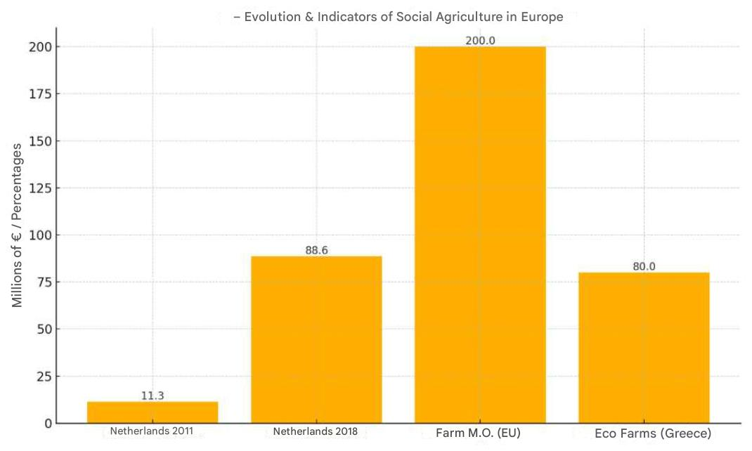

Slide 25
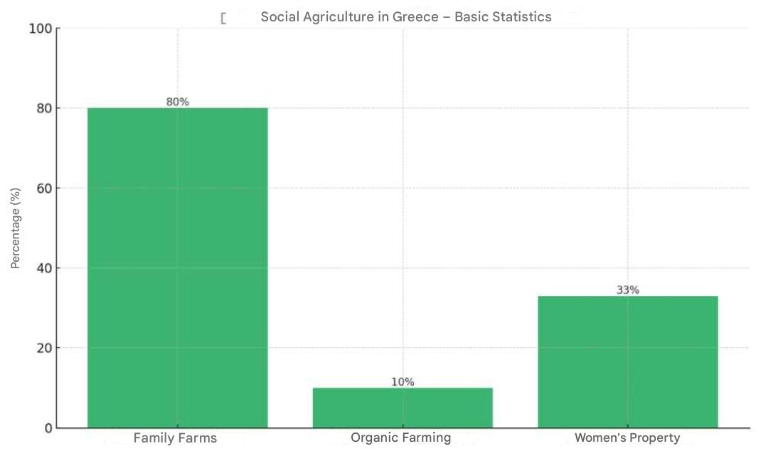
Statistic | Percentage | Year | Source
Family farms | ~80% | 2020 | Eurostat / FABLE Consortium
Organic farming | ~10% | 2021 | FoodTank / URGENCI
Owned by women farmers | ~33% | 2019 | SAGE Journals

Slide 26

Useful Links
1. Social Farmin: https://www.youtube.com/watch?v=pkm8EBcxZDY
2. Network Building for Social farming https://www.youtube.com/watch?v=6nZA1uALhAU
3. Regenerative Farming in Greece
https://youtu.be/_olF6zUzcQA
4. Networks for Regenerative Farming Greece
https://youtu.be/xnxq7lC0Lnw
5. Piraeus
https://www.youtube.com/@piraeusbank/videos
5.1 Επ. 1, 2ος κύκλος: ΒΙΩΣΙΜΗ ΓΕΩΡΓΙΑ, ΒΙΩΣΙΜΟΣ ΠΛΑΝΗΤΗΣ | Νερό: Ο θησαυρός που πρέπει να σώσουμε
https://youtu.be/0zYnOjE_HPc?si=1kKl48ZABLSBo0Vz

Slide 27
Useful Links
The common agricultural policy supports farmers and ensures Europe’s food security : https://agriculture.ec.europa.eu/common-agricultural-policy/cap-overview/cap-glance_en?prefLang=el
Κοινωνική γεωργία|Ευρωπαική Επιτροπή : https://ec.europa.eu/enrd/enrd-static/themes/social-aspects/social-farming/gr/social-farming_gr.html?utm_source=chatgpt.com
Farms and farmland in the European Union – statistics: https://ec.europa.eu/eurostat/statistics-explained/index.php?title=Farms_and_farmland_in_the_European_Union_-_statistics
Agriculture statistics - family farming in the EU: https://ec.europa.eu/eurostat/statistics-explained/index.php?title=Agriculture_statistics_-_family_farming_in_the_EU
CASE STUDY: Kerry Social Farming :https://ec.europa.eu/programmes/erasmus-plus/project-result-content/df7fd33e-76eb-4b28-b6c0-6c97bce18c7a/COFARM_Ireland%20All%20Case%20Studies.pdf?utm_source=chatgpt.com

Slide 28
Conslusions
The need for balance between social mission and economic operation.
The BMC provides a clear overview and enhances strategic thinking.
Understanding customers and revenue streams is critical for resilience.

