Slide 1


Slide 2

Chapter 4: COMMUNICATION, PROMOTION AND MEDIA COOPERATION

Slide 3
Communication as a Strategy for Social Influence and Sustainability
Social farming is not simply agriculture with social sensitivity. It is a model of social innovation, and every social innovation must “speak” — that is, communicate the why, the how, and the who.
Here, communication is not decoration or mere transmission of information. It is:
A mechanism for connecting with the community.
A lever for visibility and recognition.
A tool for changing social attitudes.
A channel for attracting funders, consumers, and partners.

Slide 4
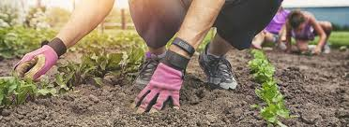
What is Marketing for a Social Farm?
More than Selling: It is the cultivation of a relationship with the community.
It combines: Visibility, Credibility, Trust, Social Responsibility.
Dual Purpose:
Economic (e.g., product sales)
Social (e.g., empowerment of vulnerable groups, sustainable development)

Slide 5
Objectives of Marketing in Social Farming
Social farming combines agricultural production with social goals, such as the inclusion of vulnerable groups, local development, and environmental Protection.
The role of marketing here is not limited to the simple promotion of products or services; it aims to communicate a value that encompasses social, environmental, and economic benefits.

Slide 6
Objectives of Marketing in Social Farming 1/4
1. Highlighting the Social Mission
Objective: To make clear the social message behind production.
How it is achieved:
Using storytelling that showcases social impact.
Showcasing the people involved (e.g., individuals from vulnerable groups).
Example: A farm employing people with disabilities communicates not only the product, but also the fact that each purchase supports their inclusion in the workforce.
2. Differentiation from the Traditional Market
Objective: To highlight the characteristics that make the products or services unique.
How it is achieved:
Emphasizing local, organic, or traditional production.
Using certifications (e.g., Fair Trade, Organic, Social Enterprise Mark).
Example: Jams produced by hand in small batches using local fruit varieties.

Slide 7
Objectives of Marketing in Social Farming 2/4
3. Building Trust and Transparency
Objective: To create a long-term relationship of trust with consumers.
How it is achieved:
Providing complete information about product origin.
Organizing visits to the production site.
Example: Open farm days where consumers can see the production process.
4. Creating Stable Demand
Objective: To ensure the economic sustainability of the initiative.
How it is achieved:
Establishing contracts with local shops, restaurants, or schools.
Creating subscription services (e.g., weekly baskets).
Example: A “Weekly Basket” program offering fresh vegetables for members.

Slide 8
Objectives of Marketing in Social Farming 2/4
3. Building Trust and Transparency
Objective: To create a long-term relationship of trust with consumers.
How it is achieved:
Providing complete information about product origin.
Organizing visits to the production site.
Example: Open farm days where consumers can see the production process.
4. Creating Stable Demand
Objective: To ensure the economic sustainability of the initiative.
How it is achieved:
Establishing contracts with local shops, restaurants, or schools.
Creating subscription services (e.g., weekly baskets).
Example: A “Weekly Basket” program offering fresh vegetables for members.

Slide 9
Objectives of Marketing in Social Farming 3/4
5. Education and Public Awareness
Objective: To inform people about the social and environmental benefits of social farming.
How it is achieved:
Educational workshops for schools and communities.
Participation in local fairs and festivals.
Example: Organizing a “Biodiversity Day” with guided tours and tastings.
6. Networking and Partnerships
Objective: To increase outreach and access to new markets.
How it is achieved:
Collaboration with other social enterprises, NGOs, and local organizations.
Creating consortia for collective promotion.
Example: A collective marketplace for social products in a city.

Slide 10
Objectives of Marketing in Social Farming 4/4
7. Increasing Social Impact
Objective: Not just sales, but improving the lives of beneficiaries.
How it is achieved:
Measuring and showcasing social outcomes (Social Impact Reports).
Using profits to expand social initiatives.
Example: Reporting that 70% of profits are reinvested in training programs.

Slide 11
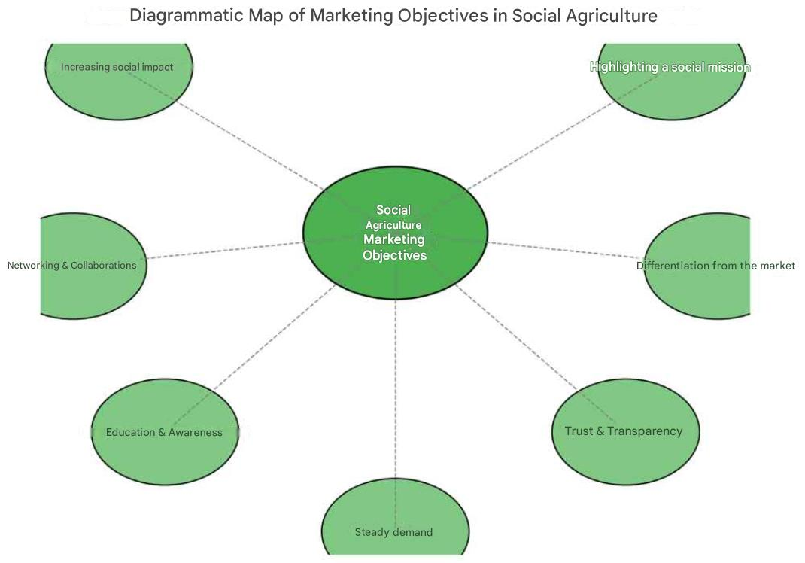

Slide 12
Objective | Indicative KPI
Highlighting the Social Mission | Percentage of campaigns with a social message
Differentiation | Number of certifications/labels
Trust | Customer satisfaction score
Stable Demand | Recurring sales per month
Public Education | Participation in awareness-raising activities
Networking | New partnerships per year
Social Impact | Number of beneficiaries
Proposed Goal Measurement Indicators (KPIs)

Slide 13
The Marketing Mix in Social Farming (4Ps)
Product: Not only agricultural products, but also social services.
Price: Price + value of social contribution.
Place: Local markets, e-shops, cooperative outlets.
Promotion: Storytelling, events, local networks.

Slide 14
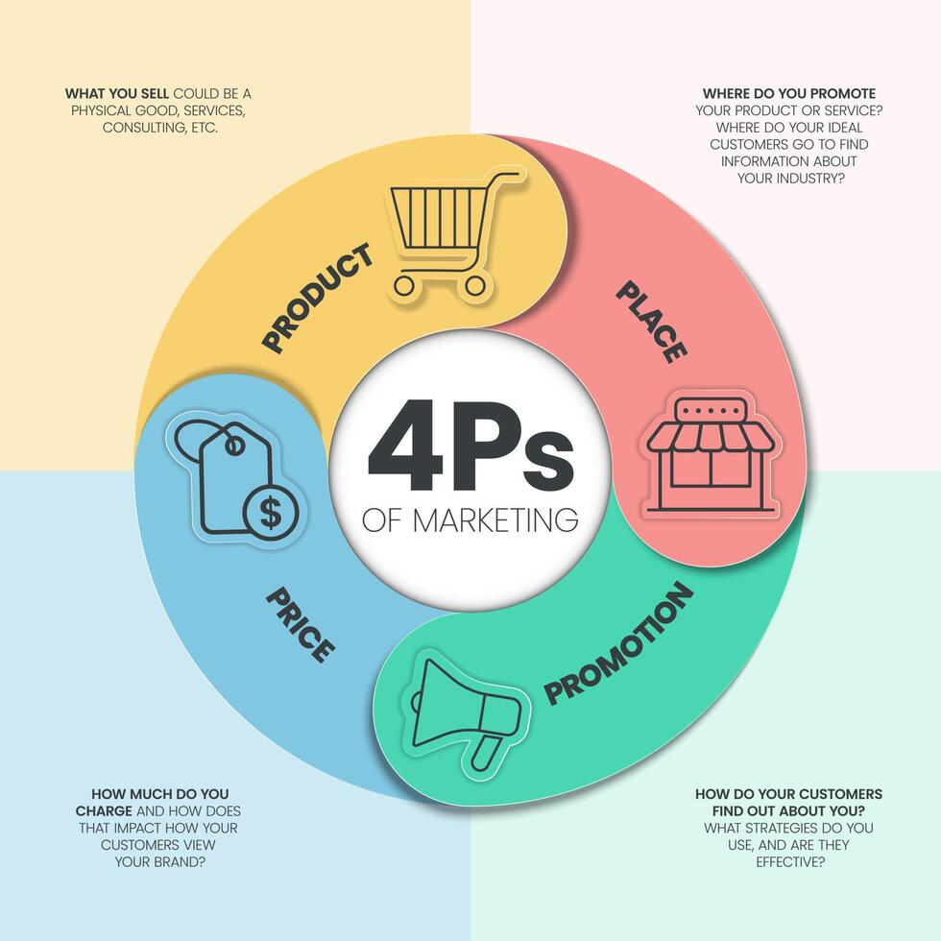
The Marketing Mix in Social Farming (4Ps)
Product: Not only agricultural products, but also social services.
Price: Price + value of social contribution.
Place: Local markets, e-shops, cooperative outlets.
Promotion: Storytelling, events, local networks.

Slide 15
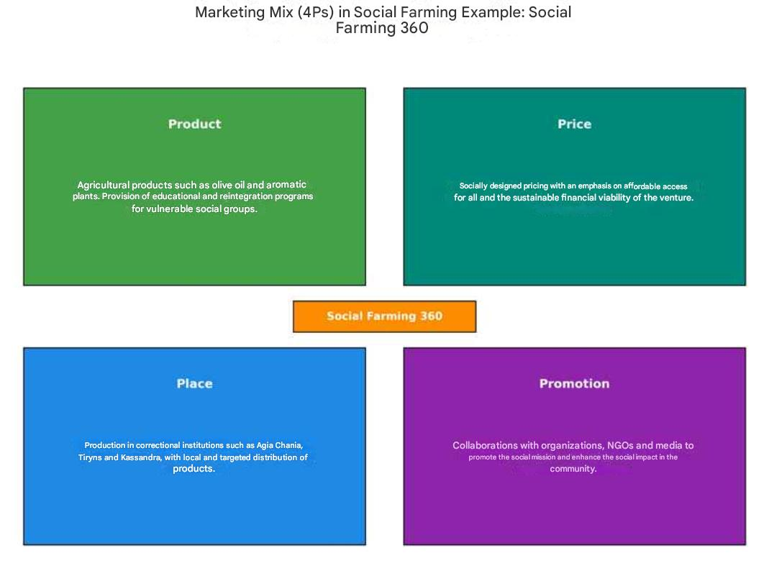

Slide 16
4.1 Storytelling as a Strategic Tool
✔ What is storytelling?
Quite simply: the story you tell about yourself.
But in the social economy, your story is not private. It is a shared good, because it influences:
How society sees you.
Whether funders trust you.
Whether young people want to get involved.
Whether someone feels “part of the solution” when they buy from you.
✔ What storytelling is NOT:
It is not just a nice advertisement.
It is not a standard press release.
It is not simply “we do farming and social inclusion.”
✔ What makes storytelling powerful?
It starts with the “why.”
People are not inspired by what you do, but by why you do it (see Simon Sinek – Start with Why).
It has real people.
Who changed through your action? What did they go through? What did they gain?
It shows change.
From need → to empowerment → to outcome.
It is alive.
It does not end with a single campaign. It is renewed, evolves, and follows the life of the farm.

Slide 17
4.2 Narrative Communication – Storytelling
✔ Theoretical Background
Storytelling works through the ancient human need for meaning. From myths to social media, stories are what connect us.
In social farming, stories:
Challenge stereotypes about vulnerable groups.
Build bridges of empathy with society.
Transform beneficiaries into heroes of their own journey.
✔ Τεχνικές storytelling:
Technique | Description | Example
Hero’s Journey | You show a journey from difficulty → solution → empowerment | “Katerina, formerly long-term unemployed, is now a greenhouse manager.”
Multi-voice Storytelling | You give a voice to beneficiaries, volunteers, and consumers | Video interview with a worker, a trainer, and a local partner.
Visual Storytelling | Image > word. Images build trust and emotional connection. | Photo of a child and a grandfather in the vegetable garden – “two generations digging together.”

Slide 18
4.3 Communication Strategy
✔ What does it mean to “have a communication strategy”?
It means that I don’t just communicate anything, anyhow, anytime, but that:
I know whom I want to reach (target group).
I know what I want to tell them (message).
I know how to tell them (channel).
I know what I want them to do next (objective).
✔ The key questions:
Who am I addressing?
(Parents? Consumers? Donors? Public authorities? Local community?)
What change do I want to create?
(e.g., for someone to visit the farm, to fund us, to talk about us?)
What tools will I use?
(Text? Video? Social media? Leaflet? Workshop?)
What is my “voice”?
Do I want to sound serious? Accessible? Humorous? Empathetic?

Slide 19
4.3.1 Audience Analysis – Mapping Communication Profiles
What it is:
The systematic recording and understanding of the different groups a social farm addresses.
Why it is important:
To create a targeted message.
To choose the appropriate communication medium.
To increase the effectiveness of the campaign.
Practical application:
📌 Buyer Persona #1
Name: Maria, 35 years old, mother of 2 children
Values: Food safety, ethical production
Channel: Instagram, Facebook
Message: “My children eat healthy and we support something bigger.”
📌 Buyer Persona #2
Name: Yiannis, 42 years old, teacher
Values: Participation, social justice
Message: “My students learn through experience what inclusion means.”

Slide 20
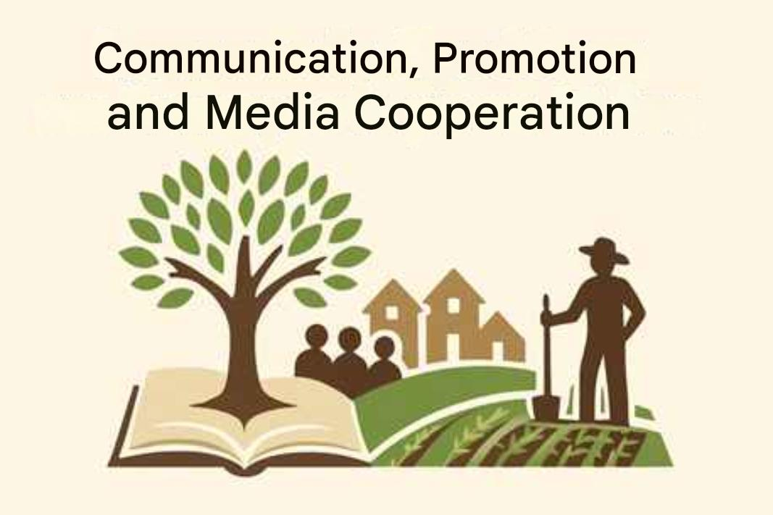
4.4 Collaboration with the Media
✔ Problems with traditional approaches:
Press releases without inspiration.
Overly technical language.
Lack of images or personal testimony.
✔ Practical suggestions:
Always have 1–2 stories “ready” for the press.
Don’t wait to be found—practice proactive communication.
Make use of annual international days (e.g., World Environment Day) for joint actions with journalists.
Turn the farm into a “place of events”: where local stories happen.

Slide 21
4.5 Digital Media & Social Media
✔ What your website should do:
Tell the story of who you are.
Showcase the social mission.
Highlight real examples, not just products.
Provide ways to get involved (subscription, visit, purchase, volunteering).
✔ Social Media Tips:
Instagram for visuals, Facebook for text and community, TikTok for emotional short stories.
Use “everyday moments” – not only “official” events.
Show challenges with honesty. It builds authenticity.

Slide 22
4.5.1 Interactive Tools for Community Engagement
What it is:
Tools and practices that enhance co-creation of content and activities.
Practical examples:
A participatory blog with articles from beneficiaries/volunteers.
“Open questions” on Instagram Stories (e.g., What would you like to see on the farm?).
A Padlet community idea wall.
A photo contest from visitors’ experiences.

Slide 23
4.6 Reputation Management and Authenticity
What it is:
The strategic promotion of the social farm with an emphasis on trust and honesty.
Risks:
Creating a false image (leads to distrust).
Inability to respond to criticism or misunderstanding.
Solutions:
Authentic content: stories, difficulties, challenges.
Active monitoring of social media.
Crisis protocol: e.g., internal problem → immediate communication → restoration of trust.

Slide 24
4.7 Community Engagement
Your farm is not just a product. It is a platform for participation.
✔ What does “communication with the community” mean?
Information → Engagement → Co-creation
From “local community as an audience” → to “local community as a participant”
✔ Proven practices:
“Harvest Festival” – an open celebration with activities, local products, and workshops.
Weekly “farm walk” for citizens/parents/children.
Joint activities with schools and social services.
Creation of a “Friends of the Farm Council” – a structure for co-designing proposals.

Slide 25
4.8 Exercise – Elevator Pitch for Storytelling
1. Purpose
The purpose of storytelling is the continuous sharing of technical, emotional, and authentic stories within a clear framework.
For social farms in particular:
Genuine storytelling rooted in the farm’s social identity.
Stories connected to lived experience, specific cases, and development goals.
2. Strategic Elements for Storytelling
Goal 1: Vision and Values
Who are we?
What stories do we have?
How do we convey them to our audience?
Goal 2: Tools
Present stories through video (images, podcast, Instagram posts).
Include a personal quote or testimony.
Goal 3: Dissemination
Share with networks, associations, or schools.
Adapt into a short, written storytelling format.

Slide 26
4.8 Exercise – Elevator Pitch for Storytelling
3. Technical Tools
Use real people: What has changed? What transformation took place?
Identify the dominant emotional voice.
Apply visual storytelling formats to highlight vulnerable groups.
Combine well-known techniques (quotes, images, short videos, podcasts).
4. Example
Structure an organized storytelling framework for a social farm.
Sample: “The dynamic transformation of Yiannis, once unemployed, now working daily with the soil, has made him the farm’s nature caretaker.”

Slide 27
4.8.1 Storytelling Exercise: “Telling My Purpose in 60 Seconds”
Purpose of the exercise:
To practice the power of storytelling your purpose through an elevator pitch.
👉 If you only had 1 minute to inspire someone about the vision of your social farm, what would you say?
Step 1: Define your WHY
What do you want to change?
What is your ultimate goal?
Step 2: Show your IDENTITY
Who are you? Are you continuing something?
What critical problem are you addressing?
Step 3: Describe the CHANGE
How are you contributing to social transformation?
What concrete results exist?
Step 4: Highlight your UNIQUENESS
How is your farm different?
How does impact happen through active participation?

Slide 28
4.9 From Marketing to Community Building
A social farm does not just sell food — it builds community.”
From passive consumer → to active participant.
Creation of a “community of supporters.”
Transformation of the customer into an “ambassador” of the social farm.

Slide 29
Business Model Canvas with Social Impact
Resources
Land
Workers with barriers (e.g., vulnerable groups)
Volunteers
Capital
Value Propositions
Organic products with social contribution
Customer Relationships
Community
Participation
Transparency
Channels
Markets
E-shop
Social events
Key Partners
Social services
Municipality
Cooperatives
Key Activities
Cultivation
Education
Social inclusion
Cost Structure
Labor
Education
Cultivation
Communication
Customer Segments
Socially conscious consumers
Local stakeholders
Revenue Streams
Sales
Donations
EU funding programs (e.g., ESPA)

Slide 30
BMC with Social Indicators & Examples
Resources
5 people from vulnerable groups
2 social workers
Value Propositions
Certified products from socially integrated individuals
Σχέσεις με Πελάτες
90% επιστροφή πελατών, μηνιαίο ενημερωτικό, open days
Channels
E-shop
Local markets
School partnerships
Key Partners
Municipality of X
EKKA (National Centre for Social Solidarity)
Schools
Cooperatives
Key Activities
Empowerment of beneficiaries
Educational programs
Cultivation
Cost Structure
Salaries of social staff
Support expenses
Customer Segments
200+ families
3 schools
1 local business
Revenue Streams
€45,000 annually from sales and sponsorships

Slide 31
Social Communication – KPIs and Success Indicators
Visibility:
Increase social media followers by 20% annually
Engagement:
Number of participants in events / open days
Trust:
% satisfaction from community/customer surveys
Social Inclusion:
Number of beneficiaries who moved into employment
Networking:
New partnerships with local stakeholders per year
Impact:
Number of success stories published

Slide 32
🎥 Video Example
https://www.youtube.com/watch?v=RMuyqUcWYzY
Presentation of a social farming initiative, featuring real people.
Visuals, emotions, music.
Ideal for use in screenings, events, and presentations.

Slide 33
CONCLUSIONS
Whoever doesn’t tell their story, someone else tells it for them — or no one ever learns it.
In social farming:
Communication is not a luxury, it is a basic need.
It is not about promotion, but about collective identity and transformative influence.
What is needed:
A well-structured narrative.
A variety of channels.
Strategic targeting.
An interactive relationship with the community.

