Slide 1


Slide 2

Social Farming Activities for local communities

Slide 3
Topics
Social Farming: definition and activities
Benefits of social farming for communities
Activities and services for local communities
Examples of services for local communities
  Educational services for early childhood
    Agri-nursery
    Agri-preschool
  Social and care services
    Day care centres

Slide 4
Social farming
Social farming
Its aims are to promote social inclusion, to enhance the wellbeing of people and support local communities' development.
Among the activities of social farming, we can list: agri-nursery, day care centres, social gardens, programmes for the social and work inclusion of disadvantaged people.
is a set of practices integrating farming activity and social, educational and therapeutical services.

Slide 5
Social farming
In Italy, social farming is regulated by the
Law 141 of 2015 “Dispositions on the matter of Social agriculture”
defining the kind of activities, the aims, the subjects eligible to operate in the sector, the procedures for the public recognition of operators and the identification of beneficiaries.

Slide 6
Social farming
Law 141 of 2015 “Disposition on the matter of Social Agriculture”
Article 2 lists four typologies of social farming activities:
Social and work inclusion of workers with disabilities and disadvantaged workers, of disadvantaged workers and minors in working age included in rehabilitation and social support projects;
Social and service provision for local communities through the use of the tangible and intangible resources of agriculture in order to promote, accompany and implement actions aiming at developing abilities and capacities, social and labour inclusion, recreation and useful services for everyday life;
Provisions and services which support and assist medical, psychological, and rehabilitative therapies aimed at improving the health conditions and social, emotional, and cognitive functions of the subjects involved, including through the use of farmed animals and plant cultivation;
Projects for environmental and food education, biodiversity conservation and the dissemination of local knowledge through the organization of social and educational farms, as well as initiatives for the reception and staying of preschool children and people with social, physical, and mental health difficulties.

Slide 7
Social farming
According to regulations, childcare services in rural areas are included among the activities provided for in point b) of Article 2 of Law 141/2015.
However, the regulations to which childcare services refer for their organization and management are those at the regional level relating to childcare services, multifunctional agriculture, and/or social agriculture.

Slide 8
Benefits of social farming
Social farming
mainly brings two kinds of benefits:
Social benefits
Economic benefits

Slide 9
Benefits of social farming
Agricultural activities, outdoor life and contact with nature have positive effects on the well-being of individuals, even at psychological level, reducing stress and improving mood.
Psychological wellbeing
Social inclusion
By its very nature, social farming promotes the integration of disadvantaged people, offering them the opportunity to actively participate in the community.
Social benefits
Social farming activities represent an opportunity to learn and develop practical and social skills, leading to improved self-esteem and autonomy for the people involved.
Skills development

Slide 10
Benefits of social farming
Reduction of social costs
The social and work inclusion of disadvantaged people can lead to a reduction in the costs linked to social and health services.
Economic benefits
Social agriculture creates jobs in rural areas, contributing to local economic development and reducing unemployment.
Job creation
Support to agricultural enterprises
Through social farming activities, farms can diversify their sources of income, increasing their resilience and sustainability.

Slide 11
Activities and services for local communities

Slide 12
Activities and services for local communities
We will now look at some examples of services for local communities, i.e.:
Early childhood education services
Social and care services

Slide 13
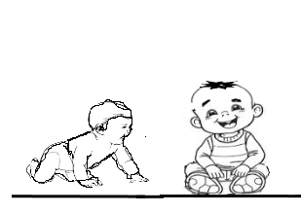
Early childhood education services
Agri-nursery
is a facility for children from 3 months
up to 3 years of age
located on a
farm or agricultural company

Slide 14
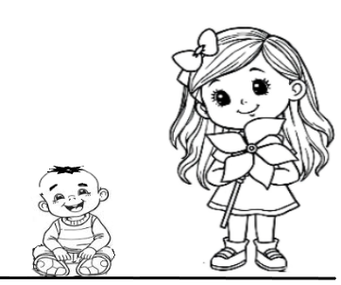
Early childhood education services
Agri-preschool
is a facility for children
between the ages of 3 and 6
also located
on a farm

Slide 15
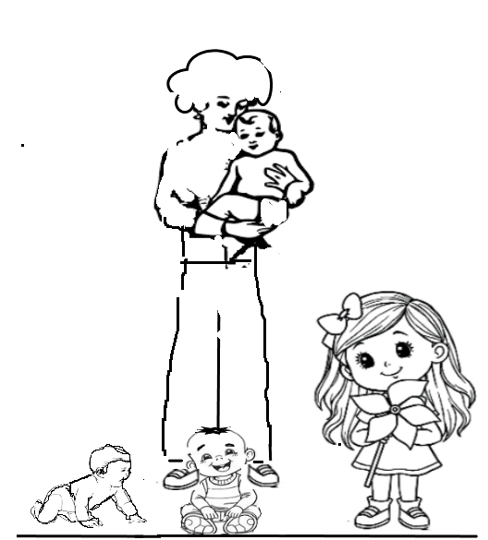
Early childhood education services
Agri-nanny
Provides a childcare service
for children aged
between 3 months and 3 years
in a home on
a farm

Slide 16
Agri-nurseries
An Agri-nursery
is a socio-educational and parental support service for children between 3 months and 3 years of age.

Slide 17
Agri-nurseries
Unlike traditional daycare centers,
they are provided by and within farms,
which offer children educational experiences integrated with agricultural activities.
Essentially, the farm uses
its own spaces, production cycles, and expertise,
providing children with the opportunity for direct, experiential, and tactile contact with nature.

Slide 18
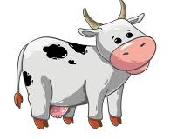

Agri-nurseries
Children participate in various activities, such as:
Caring for animals

Slide 19
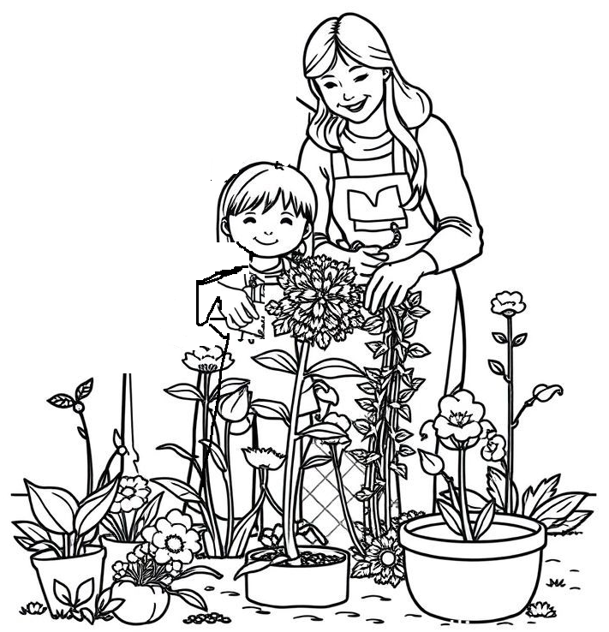
Agri-nurseries
Cultivation

Slide 20

Agri-nurseries
Creative workshops

Slide 21
Italian agri-nurseries
More than 70% of Italian agri-nurseries are concentrated in just 5 regions
(equal to 1/4 of the total Italian regions and 1/3 of the regions where there are agri-nurseries):
where, however, more than 44% of the Italian population resides.
In other 5 regions (Abruzzo, Basilicata, Liguria, Molise, Val d’Aosta) there are no agri-nurseries.

Slide 22
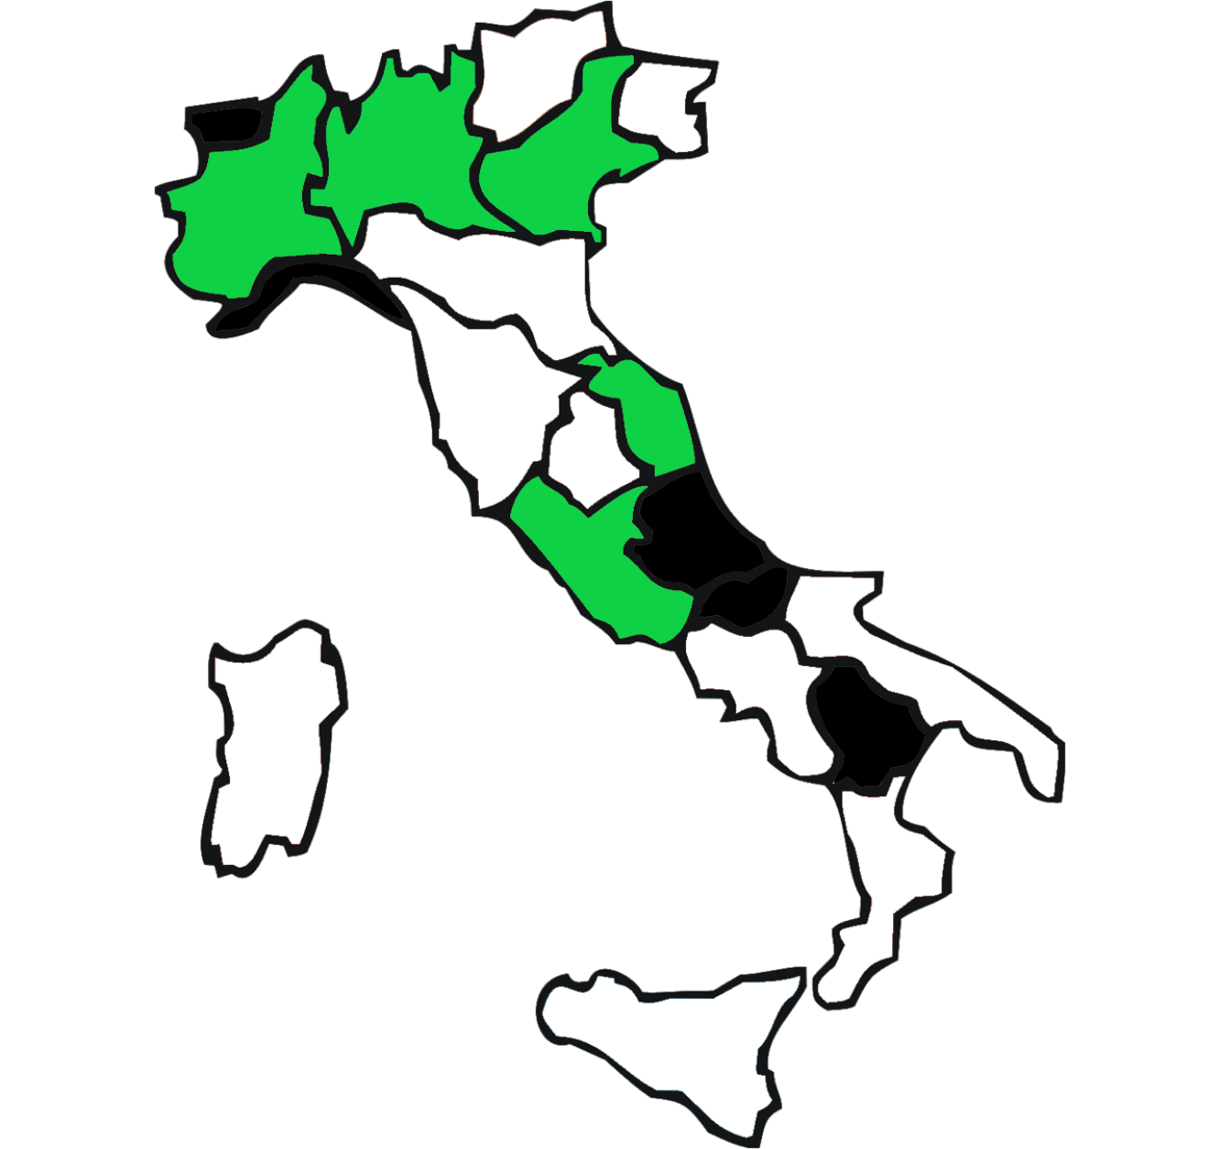
Italian agri-nurseries
Most of the supply is concentrated in northern and central Italy, as also graphically highlighted by the distribution of the 5 regions with the highest number of agri-nurseries (in green).
In detail, the northern regions have 40 facilities, compared to 23 in the central regions and 10 in the southern and island areas.
In black, the 5 regions where there are no agri-nurseries are represented.

Slide 23
Italian agri-nurseries by region
(number and percentage)

Slide 24
Requirements for agri-nurseries
To operate as agri-nurseries, agricultural companies must meet certain requirements aimed at ensuring the safety and adequacy of the spaces as well as the quality of the services offered.
These requirements are of an immaterial and material nature and concern:
Personnel
Facility
Environment

Slide 25
Requirements for agri-nurseries
Personnel requirements
The staff must be made up of professional educators, who deal directly with the children, as well as professionals of various kinds, involved in training and assistance activities.
Educators must be adequately numbered for the number of children. Each educator can be responsible for a maximum of 8 children.
Continuing education must be provided and a teaching plan developed.
The coordinator should also have operational functions.
If a kitchen is available, there must be one cook and one service worker for every 30 seats.

Slide 26
Requirements for agri-nurseries
Facility requirements
The spaces must be located on the ground floor (and anyway no higher than the first floor) and the outdoor areas must be for the exclusive use of the agri-nursery.
Premises must be provided for the reception and the change of children.
Bathrooms areas must be adequate and proportionate to the number of children.

Slide 27
Requirements for agri-nurseries
Facility requirements
A kitchen or pantry with facilities for heating meals and washing dishes must be provided.
There must be restrooms and a changing room for the exclusive use of staff, as well as storage areas for cleaning supplies and teaching materials.

Slide 28
Requirements for agri-nurseries
Facility requirements
Space safety, particularly with regard to fire prevention, system safety, and the absence of barriers.
Radiators must be covered to prevent direct contact, and electrical outlets must be shielded.

Slide 29
Requirements for agri-nurseries
Environmental requirements
Safety and suitability of green spaces available to children.
Use of non-toxic and non-polluting materials and substances, suitable for the purpose and, where necessary, appropriately modified (for example, padding or surface layers).

Slide 30
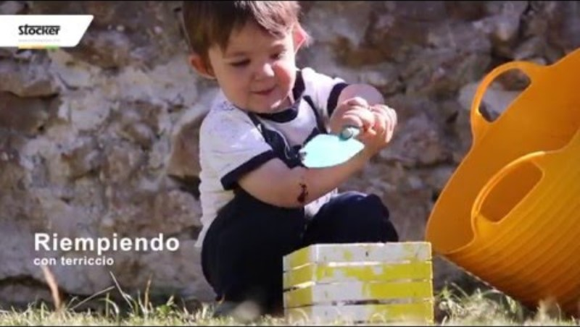
Italian agri-nurseries
Agri-nido Il cavallo a dondolo
Mezzocorona (TN)
https://www.ilcavalloadondoloagrinido.it/
https://youtu.be/OuOQ4v7xypU

Slide 31
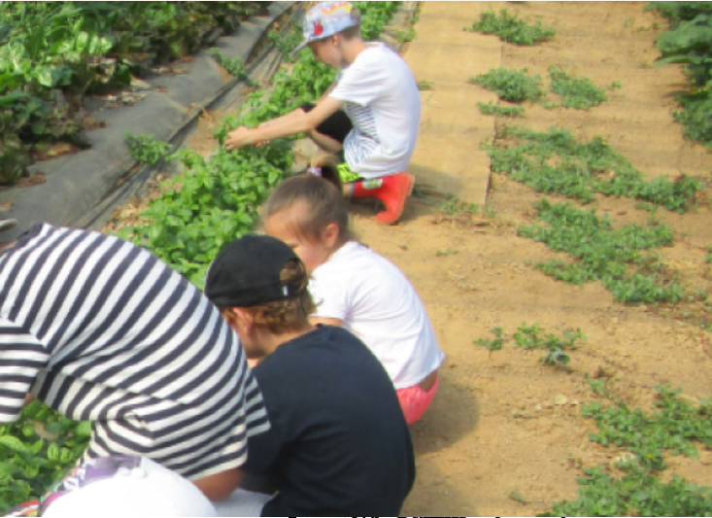
Italian agri-nurseries
Agriasilo nido Cascina Torrione
Rivarolo Canavese (TO)
https://www.cascinatorrione.it/agrinido-e-fattoria-didattica/

Slide 32
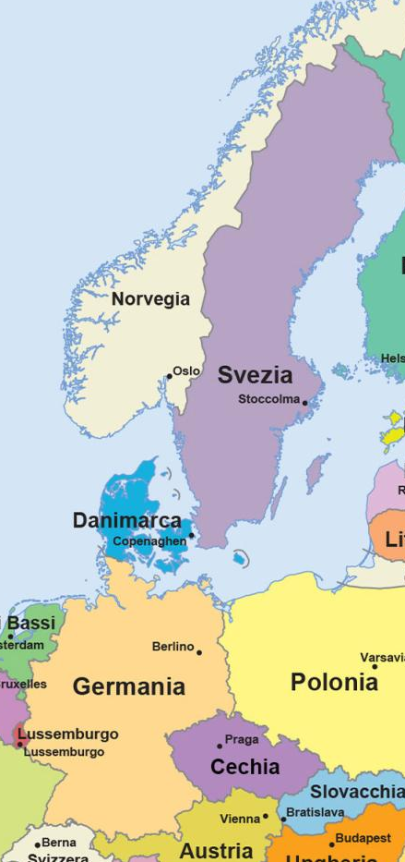



Agri-nurseries in Europe
Swedish agri-nurseries are designed to be inclusive and sustainable and place particular emphasis on interaction with nature and the promotion of a healthy lifestyle.
Agri-nurseries in Denmark have their origins in the waldkindergartens i.e. garden nurseries, established in the 1950s, which promoted outdoor education and interaction with nature.
In Germany, agri-nurseries have spread rapidly, especially in rural areas, as an alternative to urban daycare centers.

Slide 33
Agri-preschool
An Agri-preschool
is an educational facility for preschool children (ages 3-6), located on a farm.
Agri-preschools seek to integrate traditional education with agricultural activities, allowing children to learn through direct interaction with nature and animals.

Slide 34
Agri-preschools – activities and functions
An agri-preschool performs many functions and offers various activities:

Slide 35
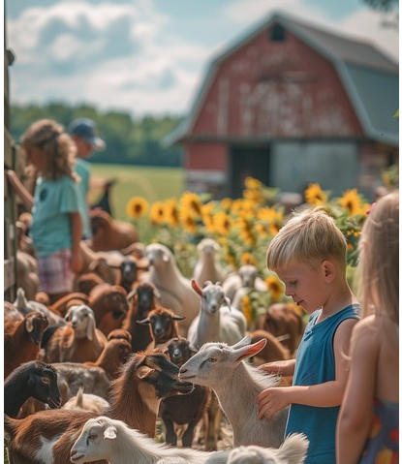
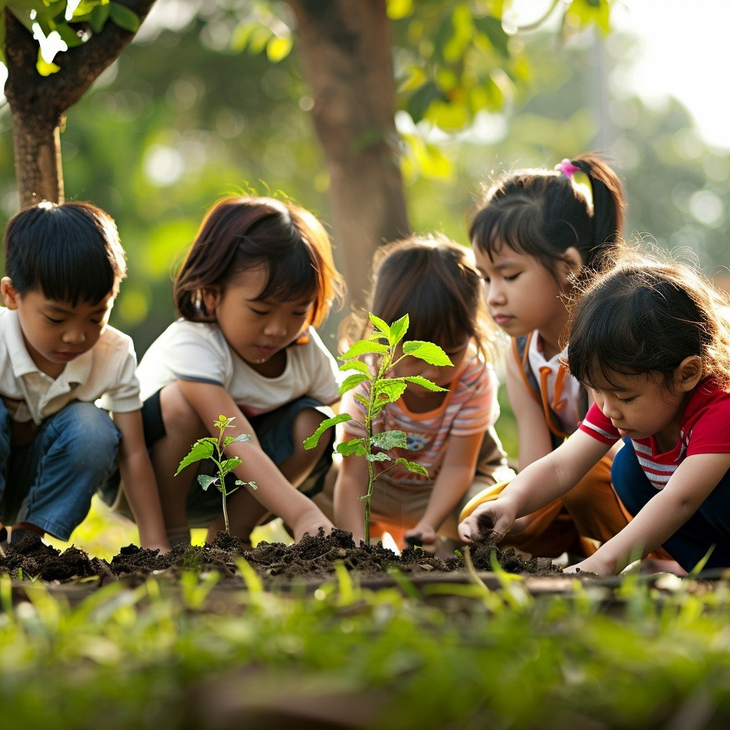
Agri-preschools – activities and functions
Environmental education
Children learn about plants, animals, and natural cycles through hands-on activities, such as caring for animals and planting and harvesting fruits and vegetables.

Slide 36
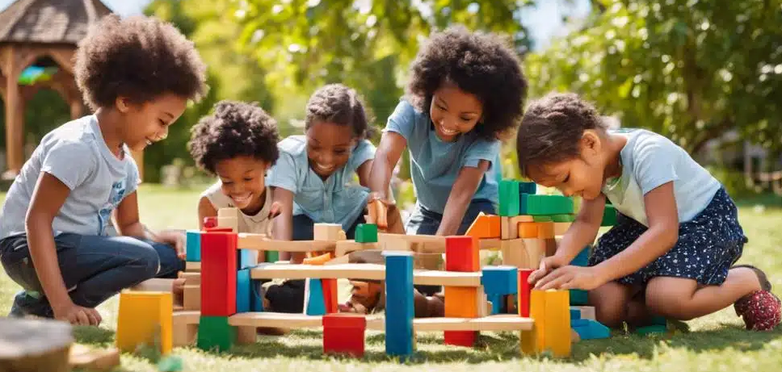
Agri-preschools – activities and functions
Development of social skills
Thanks to peer interaction, the ability to work in a team improves as well as respect for others and the child's social skills.

Slide 37

Agri-preschools – activities and functions
Psychological wellbeing
Outdoor activity and contact with nature help improve the mental and physical health of children too.

Slide 38
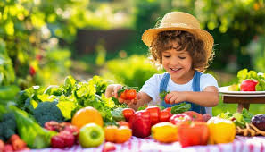
Agri-preschools – activities and functions
Food education
Agri-preschools offer children the opportunity to learn how to grow vegetables and fruits, promoting a healthy and balanced diet.
Children learn to eat organic and healthy products grown directly on the farm.

Slide 39
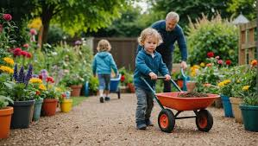
Agri-preschools – activities and functions
Motor skills development
Outdoor activities improve the child's motor skills also through participation in games and physical activities.

Slide 40

Italian agri-preschools
Agriasilo «La Piemontesina»
Chivasso (TO)
https://www.facebook.com/LaPiemontesina

Slide 41
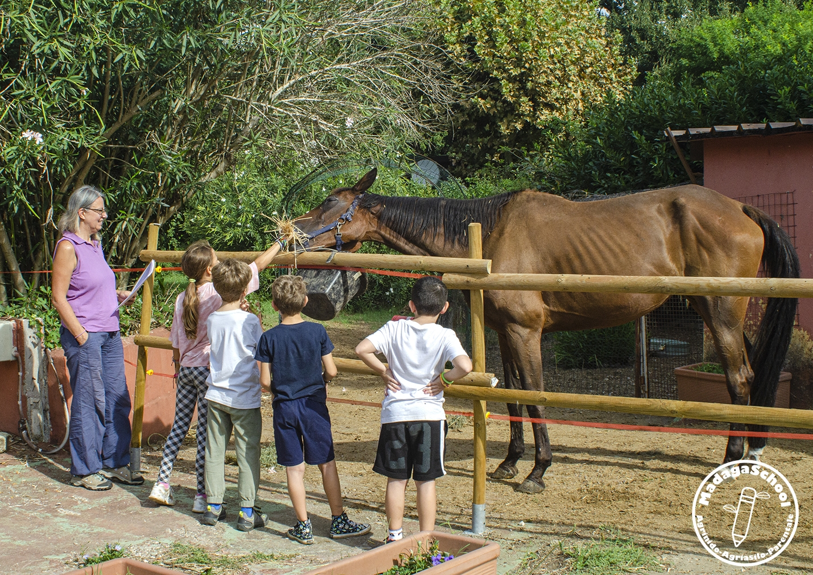
Italian agri-preschools
MadagaSchool
Roma
https://www.madagaschool.it/

Slide 42
Agri-preschools in Europe
Danish agri-preschools are integrated into farms and offer children the opportunity to participate in daily agricultural activities.
These programs are designed to promote learning through interaction with nature and animals.
An agri-preschool near Copenhagen has had a positive impact on the local community by improving environmental awareness and sustainability.

Slide 43
Agri-preschools in Europe
In Germany, agri-preschools are primarily located in rural areas.
The educational programs combine traditional education with agricultural activities, such as caring for animals and tending plants.
An agri-preschool in Bavaria has demonstrated how its activities improve children's cognitive and social skills and thus promote social inclusion.

Slide 44
Agri-preschools in Europe
In Sweden, agri-preschools are designed to be inclusive and sustainable.
Their educational programs focus on interacting with nature and promoting a healthy lifestyle.
An agri-preschool near Stockholm has seen a positive impact on the local community by promoting environmental sustainability and ecological education.

Slide 45
Benefits of early childhood education services
This typology of services, provided within companies practicing social farming, has three main beneficiaries:
Children
Families
Communities

Slide 46
Benefits of early childhood education services
Among the benefits for children:
Cognitive development: agri-nurseries and agri-preschools promote the development of children's cognitive skills, including problem-solving and creativity.
Psychological wellbeing: interaction with nature and animals contribute to the psychological wellbeing of the child, reducing stress and improving mood.
Social skills: agri-nurseries promote the development of social skills such as cooperation and prosocial behaviour. Children learn to work together and respect others.
Motor skills: Outdoor activities improve children's motor skills, especially gross motor skills.

Slide 47
Benefits of early childhood education services
Among the benefits for families:
Parenting support: agri-nurseries and agri-preschools provide a stimulating and safe environment for children, giving parents the opportunity to better balance their private and work lives.
Social inclusion: agri-nurseries and agri-preschools promote social inclusion, creating socialization opportunities for families and improving the cohesion of the entire community.

Slide 48
Benefits of early childhood education services
Among the benefits for communities:
Environmental sustainability: agri-nurseries and agri-preschools promote sustainable agricultural practices and environmental awareness among children and their families.
Local economy: agri-nurseries and agri-preschools can contribute positively to the local economy by creating and supporting local agricultural businesses.

Slide 49
Other services for the community
A Day care centre
is a facility located within a farm that offers care services and recreational activities during the day.
These centers are designed to accommodate older people, people with disabilities, or those with other specific needs, offering them a safe and stimulating environment integrated with agricultural activities.

Slide 50
Day care centres - Activities
Among the activities that day care centers can offer:
Reception and hospitality: day care centers, during the day, receive their guests, providing them with a safe place where they can spend time in company, participating in various agricultural and recreational activities.
Agricultural activities: guests are involved in various activities such as caring for animals and manage the vegetable garden.
Recreational activities: games, art workshops, music and theatre to stimulate the guests' cognitive and social skills.
Canteen service: day care centers provide meals and snacks during the day, often using fresh organic products produced directly on the farm itself.
Support to families: day care centers provide support to families, easing the daily burden of care and offering alternative forms of care.

Slide 51
Conclusions
Social farming is certainly an interesting opportunity for both farms and communities thanks to the various services it can offer to different types of recipients (e.g., children, the elderly, people with disabilities).
However, it is necessary to carry out some contextual analysis steps such as:
Identify local needs (user type, service type, area demographics).
Define the utility of potential services (job creation, reduction of social exclusion) and implementable mechanisms to ensure their quality.
Feasibility analysis of potential services based on your company's specific needs (presence of a similar offering, structural limitations or deficiencies).
Analysis of potential stakeholders and their involvement (companies, municipalities, local health authorities, school boards).
Territorial networking.
Evaluation of other contextual factors (funding sources, special regional programs).

