Slide 1


Slide 2

Evaluation of efficacy and effectiveness
Cost-Benefit Analysis and SWOT Analysis

Slide 3
CBA – Cost-Benefit Analysis
It’s a methodology used to assess the efficacy of normative policies, initiatives and interventions
It determines whether the social benefits of a certain intervention or policy outweigh its social costs
A project is profitable when the benefits exceed the total expenses

Slide 4
CBA – Cost-Benefit Analysis
The analysis is usually conducted ex ante to determine whether or not to use funds to implement a project, policy, or regulatory intervention.
In some cases, an ex post analysis is also conducted to verify that objectives have been achieved.

Slide 5
CBA – Cost-Benefit Analysis
A correct analysis involves the implementation of 6 phases:
definition of the scope of analysis and identification of relevant costs/benefits: analysis of the territory (geographical area), time frame and recipients
Identification of costs/benefits and unit of measurement
quantitative cost/benefit forecasting: forecasts and estimates are made. The longer the time frame the greater the uncertainty of the estimates
cost/benefit monetization: after having determined costs and benefits, we proceed to assing them a monetary value
Intertemporal discounting and aggregation of costs and benefits: intertemporal discounting allows us to compare previously determined costs and benefits over time
Sensitivity analysis: The sensitivity obtained from the output is verified. Using the partial analysis technique, the assumptions are considered in isolation and the net benefit for each of them can be calculated.

Slide 6
CBA – Cost-Benefit Analysis
Main challenges
The main criticality is when you have benefits that are not directly monetizable. In these cases, different techniques are used, derived from CBA but with different aspects regarding the measurement of benefits with non-monetizable units of measurement.
CEA – Cost-Effectiveness Analysis: it quantifies non-monetizable benefits through their effectiveness.
CUA –Cost-Utility Analysis: it uses the measure of utility expressed in terms of Quality- Adjusted Life-Years, i.e. years of quality gained (it is mainly used in medical field)
However, all three methods are based on cost dynamics and are not very suitable for evaluating practices that generate high social benefits, which are difficult to measure.

Slide 7
SWOT Analysis
Born more than 60 years ago.
Applied within business contexts with high levels of uncertainty and competition.
Later applied to the evaluation of regional programs and public intervention decisions.
The analysis identifies the growth potential of a sector or specific area of ​​interest by enhancing its strengths and managing its weaknesses within a framework of opportunities and threats arising from the external context.
The analysis can be carried out either by the researcher, who individually analyzes the four variables (strengths, weaknesses, threats, opportunities, and risks), or through a participatory approach through stakeholder engagement.
It can be carried out in different phases: ex ante – during the forecasting phase, ongoing – to address specific critical issues, and ex post – to evaluate and contextualize the final results.

Slide 8
SWOT Analysis
Even in this case, we have 6 phases:
1. Analysis of the territorial context: identifying trends and challenges
2. Planning of actions to be taken to overcome any problems identified
3. External context analysis: identification of threats and opportunities in the sector in which the organization operates
4. Internal context analysis: identification of strengths and weaknesses of the organisation in overcoming obstacles
5. Building the SWOT matrix (see image 1)
6. I dentification of actions that, starting from strengths and opportunities, can reduce weaknesses and threats
The main critic point of the system lies in the distortions, especially in the description of complex realities such as that of social agriculture, which can be created due to the subjectivity of the analyst.

Slide 9
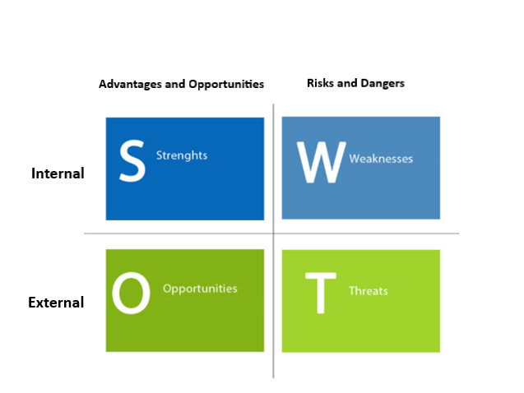
SWOT Analysis
SWOT matrix

Slide 10
Social Impact Assessment
Theory of Change
Social Return on Investment
Civil Economy Matrix

Slide 11
Social Impact Assessment
It is a method developed by a group of social scientists which founded the Interorganizational Committee on Guidelines and Principles for Social Impact Assessment (SIA).
It is usually conducted ex ante to evaluate the social consequences of policies or projects.
It involves 10 phases:
public engagement: A public engagement program is developed that will last throughout the impact assessment process. Stakeholder engagement strategies (interviews, focus groups, questionnaires) are adopted to involve all potential stakeholders in the planning decision-making process;
identification of alternatives: description of the proposed action or policy change and the alternatives. Starting from a sufficiently detailed description, the variables needed for impact assessment are identified;
basic conditions: an analysis of the context is carried out (geographical area, characteristics of the population, relationship between these and the stakeholders), the existing and past conditions associated with the human environment in which the project will take place are verified;
scoping: identification of the proposed activities’ likely social impacts, which will be discussed with all potentially affected individuals. To identify these impacts, interviews, focus groups, public surveys, and scientific literature are used.

Slide 12
Social Impact Assessment
5. projection of estimated effects and investigation of likely impacts: likely impacts are identified through 5 sources of information: data provided by project proponents, previous similar experiences, censuses and vital statistics, documents and sources, and field research;
6. forecasting responses to impacts: an attempt is made to estimate how stakeholders will respond to these impacts through comparable cases and interviews with those affected about what they expect to do;
7. indirect and cumulative impacts: we attempt to estimate both indirect impacts, i.e. those generated by direct impacts but generated at later times and in different places, and cumulative impacts, i.e. those generated by actions subsequent to and preceding the action under study but consequentially linked to it;
8. changes in alternatives occurs after all types of impacts have been identified, when all possible alternatives are analyzed to improve the impacts generated. Each alternative is then subjected to a new evaluation.
9. mitigation: this involves structuring mitigation plans to minimize any negative impacts identified during the analysis;
10. monitoring: a monitoring program is developed to verify deviations from the proposed action and any unforeseen impacts.

Slide 13
Theory of Change
It is a method born in the 90s and is usually used ex ante to establish in the planning phase the impact that one wants to generate, through the involvement of stakeholders.
It proposes a backward path starting from the change we want to generate, from the outcomes (impact on stakeholders in the short term) and from the outputs (products and services generated) to understand the resources and activities to be introduced.
It is organised in 7 phases:

Slide 14
Theory of Change
1. Identification of long-term objectives and stakeholders.
2. Outcome mapping: all outcomes are identified and placed in a sequential path according to which they should occur to generate the desired impacts. Some may act as preconditions for future outcomes.
3. Reality check: mapping of the outcomes that can be generated directly by the applicant, those that will be considered at a later stage and those that will be implemented by other stakeholders active in the context.
4. Identification of activities: description of the activities to be implemented to generate the intended change.
5. Indicator Selection: Through a combination of quantitative and qualitative metrics, we attempt to measure the desired change.
6. Hypothesis Verification: We attempt to identify the conditions necessary for the model's underlying hypotheses to be verified. If obstacles are present, we attempt to establish a strategy to overcome them.
7. Final Report: Communication of the value generated and the actions to be implemented to potentially improve the process.

Slide 15
Social Return on Investment
SROI allows social and environmental components to be expressed in monetary terms through the use of outcomes, indicators, and financial proxies used to evaluate social and environmental benefits.
Evaluative SROI, conducted ex post and based on achieved outcomes.
Forecasting SROI, conducted ex ante to assess the social value that will be generated if the expected outcomes are achieved.
SROI involves 6 phases.
1. Definition of the scope of analysis and identification of stakeholders
2. Outcome mapping
3. Quantification of outcomes and assignment of value: each identified outcome is associated with an indicator to allow for monetary measurement of the outcomes
4. Definition of impact: to avoid overestimating the outcomes, measures are applied to the identified value (measures: deadweight, drop-off);
5. Calculation of SROI: the financial value of the investment and that of the social costs and benefits are calculated
6. Return, use, integration: final report of the results obtained and verification of the results themselves

Slide 16
Civil Economy Matrix
It stems from a participatory process involving nonprofit, for-profit, and public organizations, researchers, and consultants, based on the principles of the Civil Economy.
It is used to leverage an organization's strengths, understand its long-term goals, and identify critical areas requiring intervention.
This method as well includes 6 phases:
1. Preliminary analysis: the impact goals are evaluated and compared with the principles of the Civil Economy (common good, relational good, participatory democracy, community, giving and gratuitousness, meritoriousness, inclusion, happiness, circular subsidiarity).
2. Indicator selection and data collection/analysis: from a set of 40 indicators, those needed to measure the outcomes that allow the expected impact to be generated are selected.
3. Stakeholder engagement: with the involvement of interested parties, weights are assigned to each outcome based on their preferences with respect to the value domains (each weight ranges from 0 to 5). The value assigned to the weight is then multiplied by the value assigned to the outcome.

Slide 17
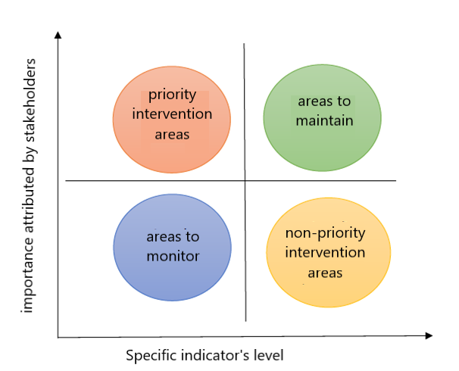
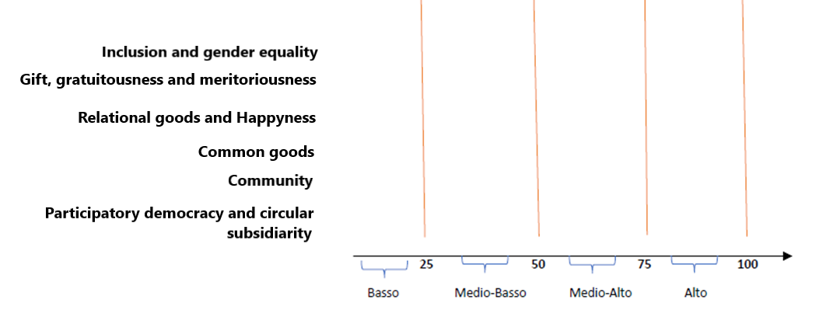
Civil Economy Matrix
4. Impact calculation: The measured values ​​multiplied by the weights are aggregated into a summary tool.
5. Results analysis: To critically analyze the results and identify areas for improvement, two tools are used: the materiality matrix and the results thermometer (see Fig. 2 and Fig. 3).
6. Communication: internal and external feedback.
Figure 1
Figure 2

Slide 18
Social Agriculture Evaluation
In Europe and beyond, the SROI methodology has been proposed for evaluating Social Farming, integrated with context assessments through SWOT analysis and business model assessments of agricultural businesses or cooperatives using the Business Model Canvas. This integrated approach helps assess the benefits Social Farming generates for the various stakeholders involved.
SROI has proven to be a particularly suitable tool for evaluating the impact of Social Farming, as it is used for project evaluation and is aligned with the ways in which Social Farming activities are implemented.
In particular, SROI has enabled the capture of three key aspects in Social Farming:
1. identification and mapping of stakeholders (project beneficiaries, promoting cooperatives, agricultural businesses hosting internships, the local community, and personal care services);
2. mapping of outcomes; and
3. construction of proxies.

