Slide 1
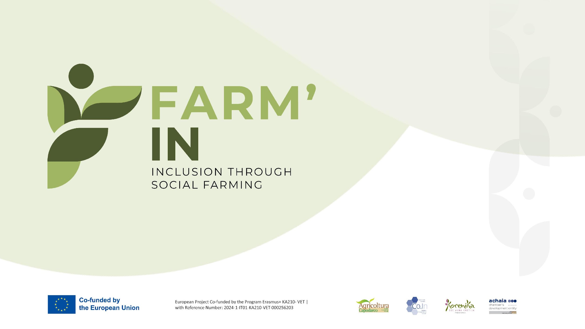

Slide 2
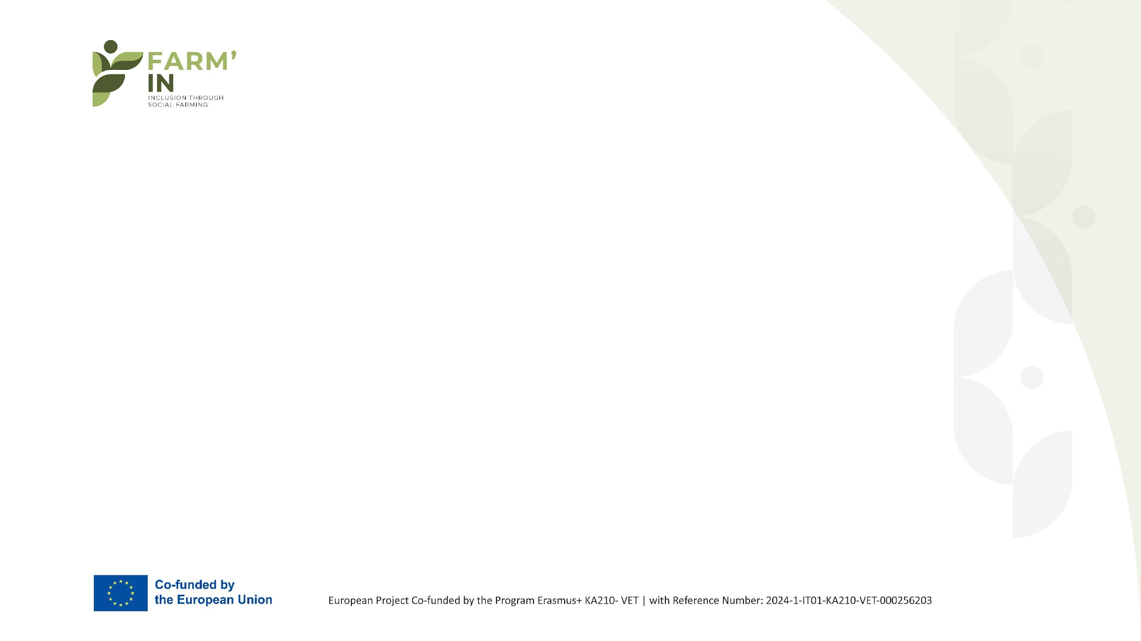
Lesson 1:
Designing & Adapting Farm Tasks

Slide 3
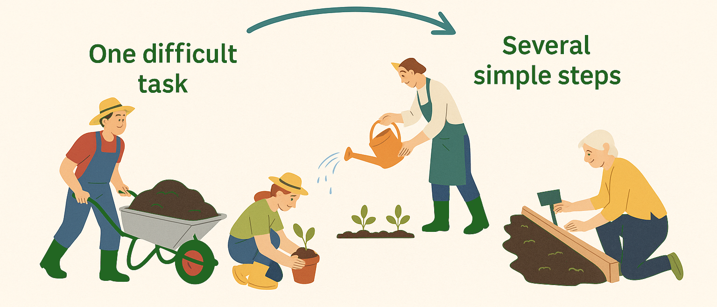
Why adapt?
Adapting farm tasks does not mean lowering standards – it means opening real work to everyone. Small adjustments allow people with different abilities to succeed, gain confidence and feel included. Predictable routines and clear steps build trust and motivation.
Small changes make big inclusion.
Clear steps = confidence & success.
Adaptation opens real farm work to everyone.

Slide 4
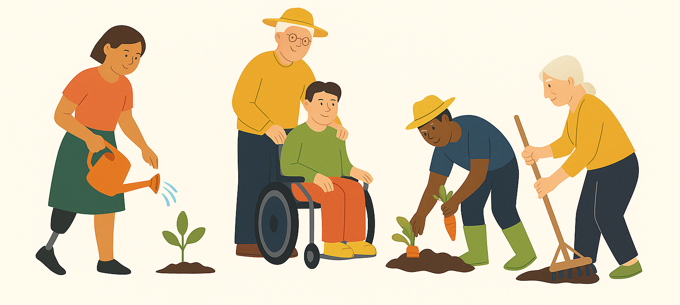
Who We Welcome
Each group brings strengths – adapting tasks allows everyone to participate.
Social farming creates space for everyone to belong: elderly, people with disabilities, youth at risk, mental health recovery, migrants, people in recovery
Each group brings unique strengths and faces different barriers.
Adapting tasks ensures participation, dignity and real contribution.

Slide 5
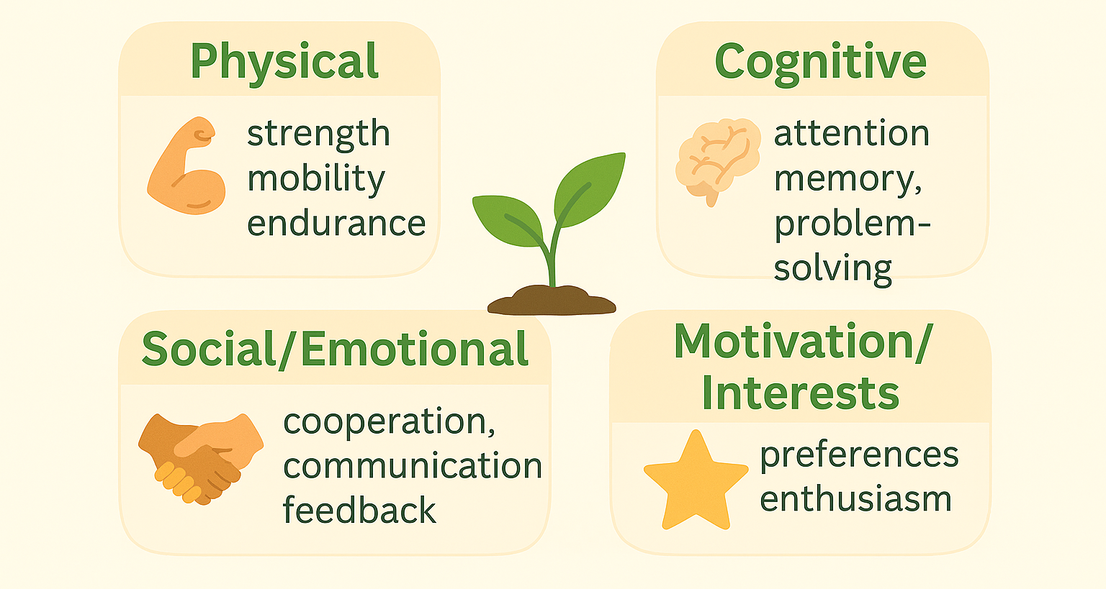
Assessment: 4 Lenses
When including vulnerable groups in farm work the first step is to understand their abilities and needs. Assessment does not mean formal testing – it means observing, listening and using simple activities to discover where each person can thrive.
Practical examples: someone who cannot lift heavy crates may be excellent at sorting herbs; a person who struggles with long instructions may succeed if tasks are broken into smaller steps or supported with visual cues.
Assessment is the foundation of successful task adaptation – once we know where a person is strong and where they need support, we can create an inclusive, safe and motivating work environment.

Slide 6
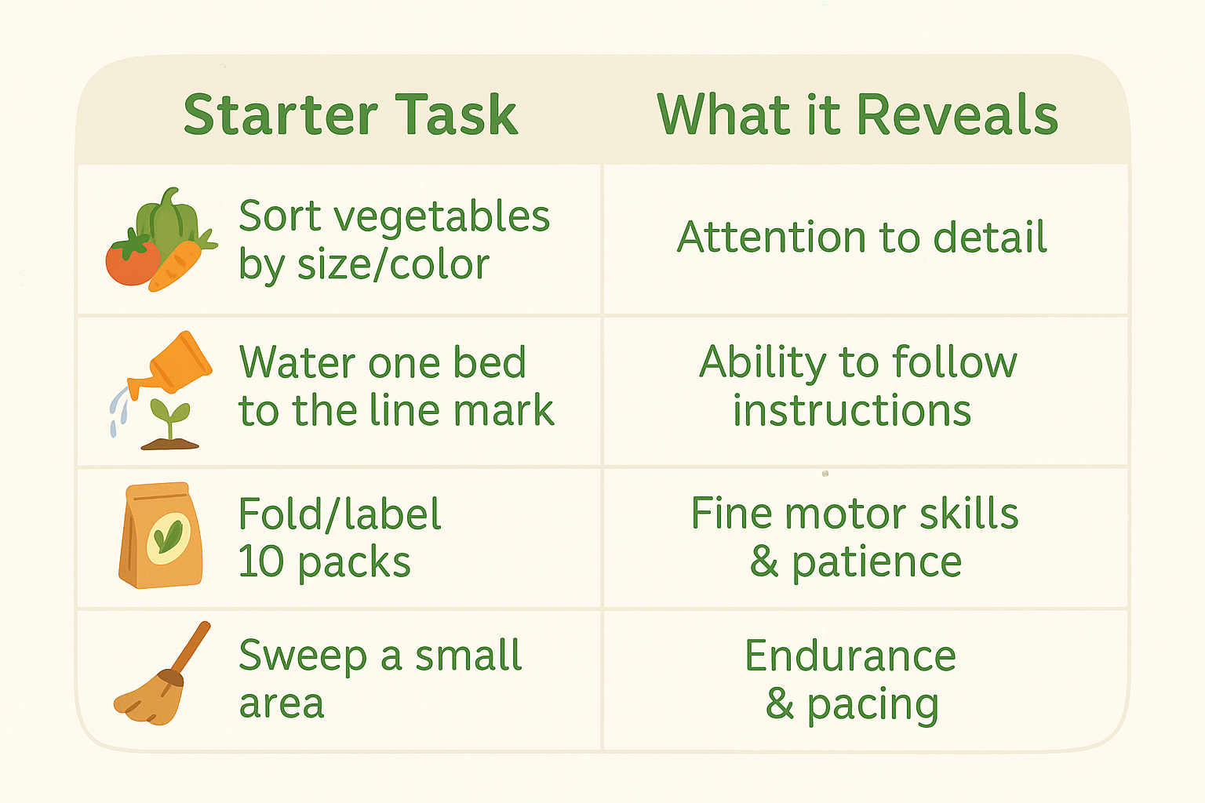
Quick Assessment Starters
Examples of quick starters:
When starting with new participants it helps to keep tasks small, simple and safe. These first activities are not about productivity – they are about getting to know a person’s rhythm, strengths and where support might be needed.
Quick starter tasks are simple, safe, and revealing – they help build trust and give mentors the insights needed to match participants with the right farm work.
These short tasks are not about output but about discovering strengths and building confidence from the very first day.

Slide 7
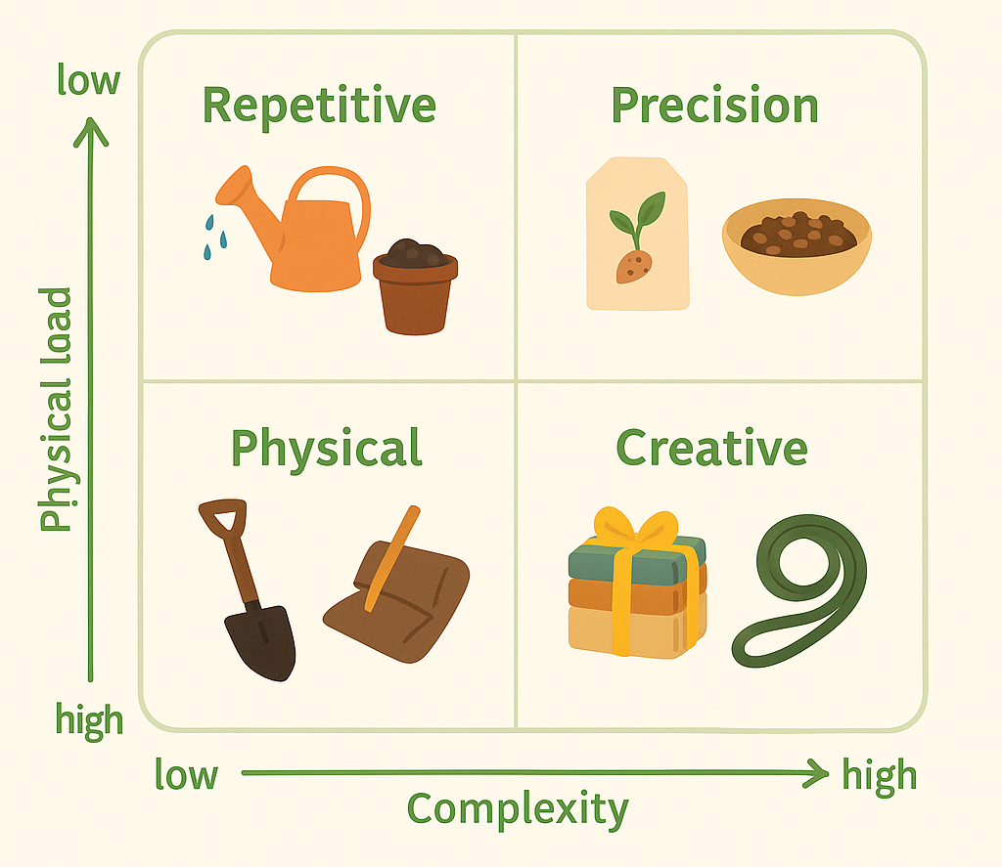
The Task Spectrum
On a farm, there are many different kinds of tasks – some are repetitive, some require precision, others are creative and some are more physically demanding. Each category offers opportunities for different people to shine. By recognizing this spectrum, mentors can assign work that matches participants’ strengths and keeps everyone engaged.
Every farm task can be adapted and has a place on the spectrum. By balancing complexity and physical effort we can make sure each participant contributes meaningfully and safely.

Slide 8
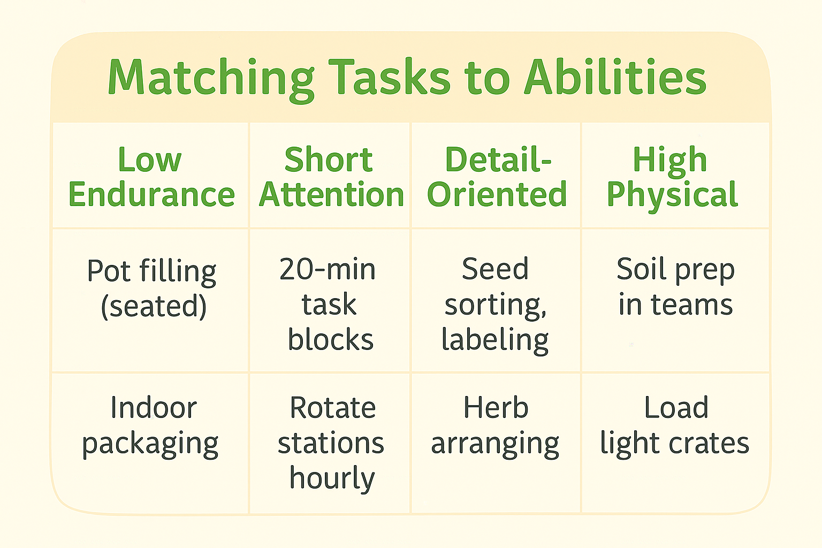
Matching Matrix (Mini-Tool)
Every participant has different strengths and needs. A single farm task can be adapted in multiple ways so that everyone can contribute. By adjusting the setting, timing, or method, the same job becomes accessible to people with different abilities.
Matching tasks to abilities is not about lowering expectations, but about opening real farm work to everyone through smart adaptation.

Slide 9
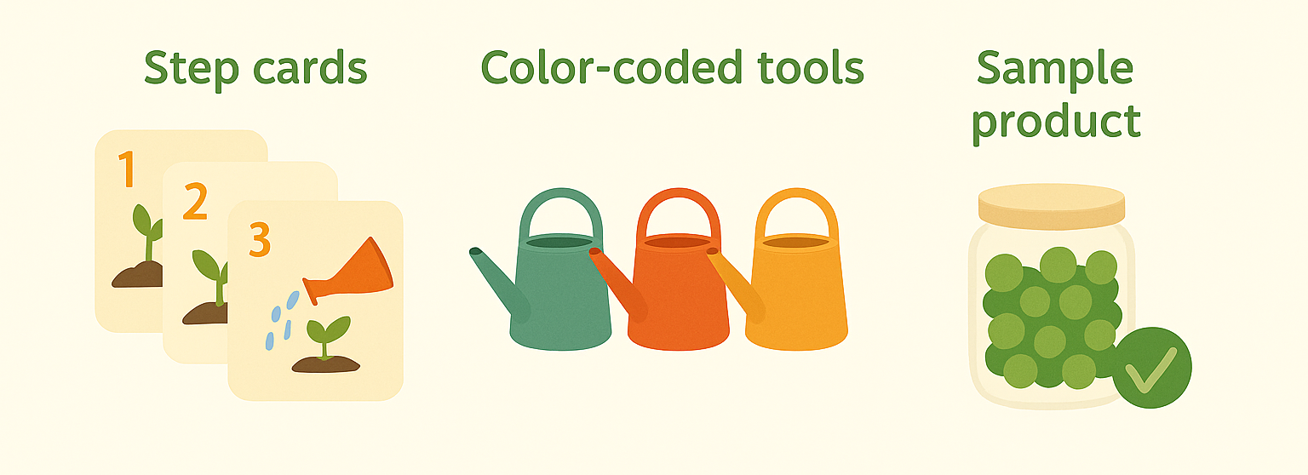
Visual Instructions Win
Every participant has different strengths and needs. A single farm task can be adapted in multiple ways so that everyone can contribute. By adjusting the setting, timing or method the same job becomes accessible to people with different abilities.
Matching tasks to abilities is not about lowering expectations but about opening real farm work to everyone through smart adaptation.

Slide 10
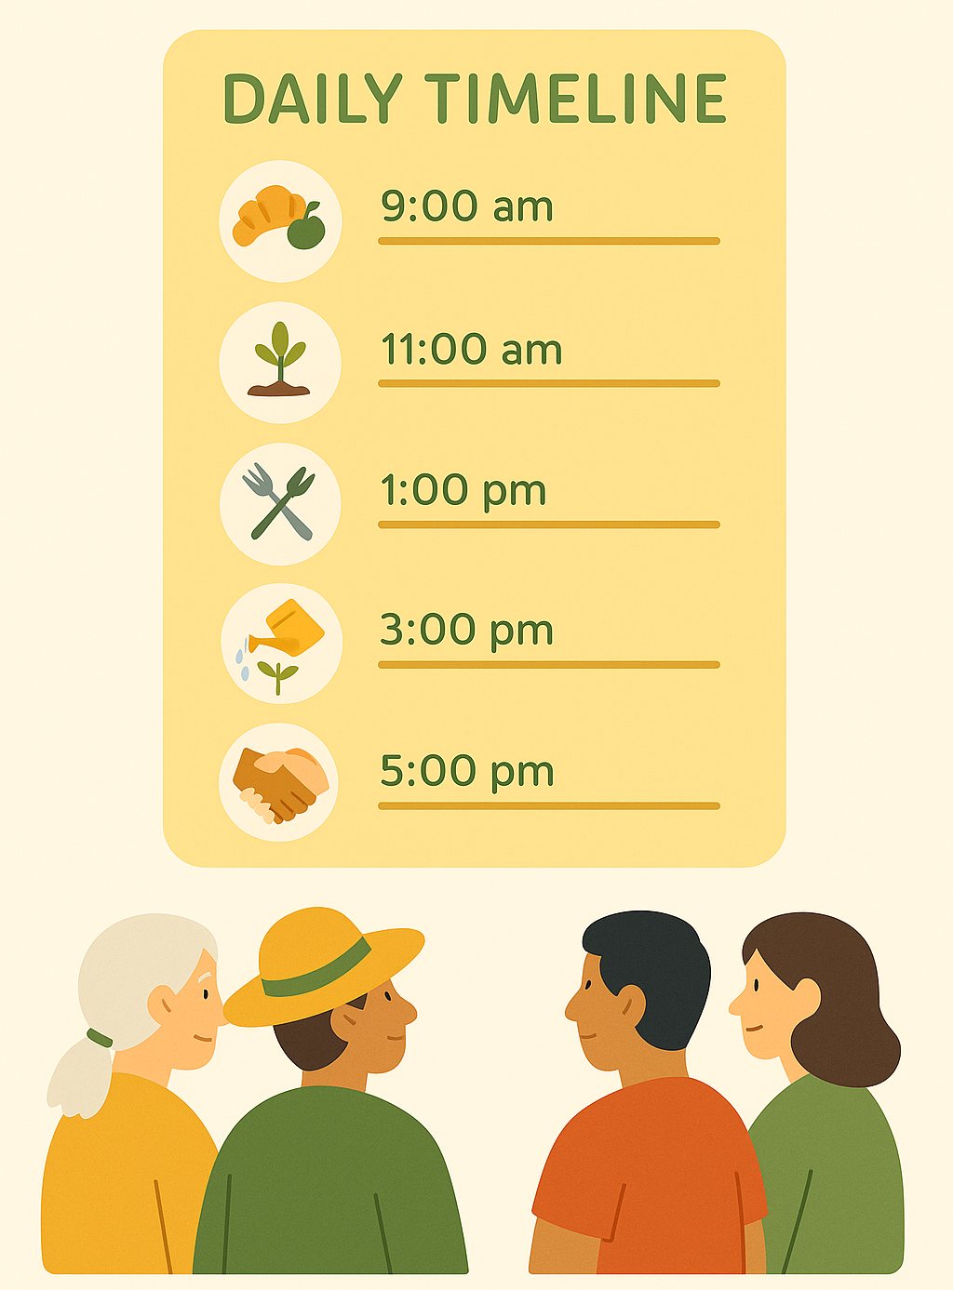
Daily Routine = Safety
Daily routines are more than schedules – they create calm, order, and predictability on the farm. For participants who struggle with anxiety, memory, or concentration, knowing what comes next reduces stress, builds trust, and reintroduces good habits like punctuality and teamwork. Clear routines also support mentors by providing structure, making supervision easier, and allowing more focus on encouragement – strengthening trust and creating a supportive learning environment.
A clear daily timeline builds safety and confidence for participants and gives mentors a structured tool to guide, support, and encourage everyone effectively.

Slide 11
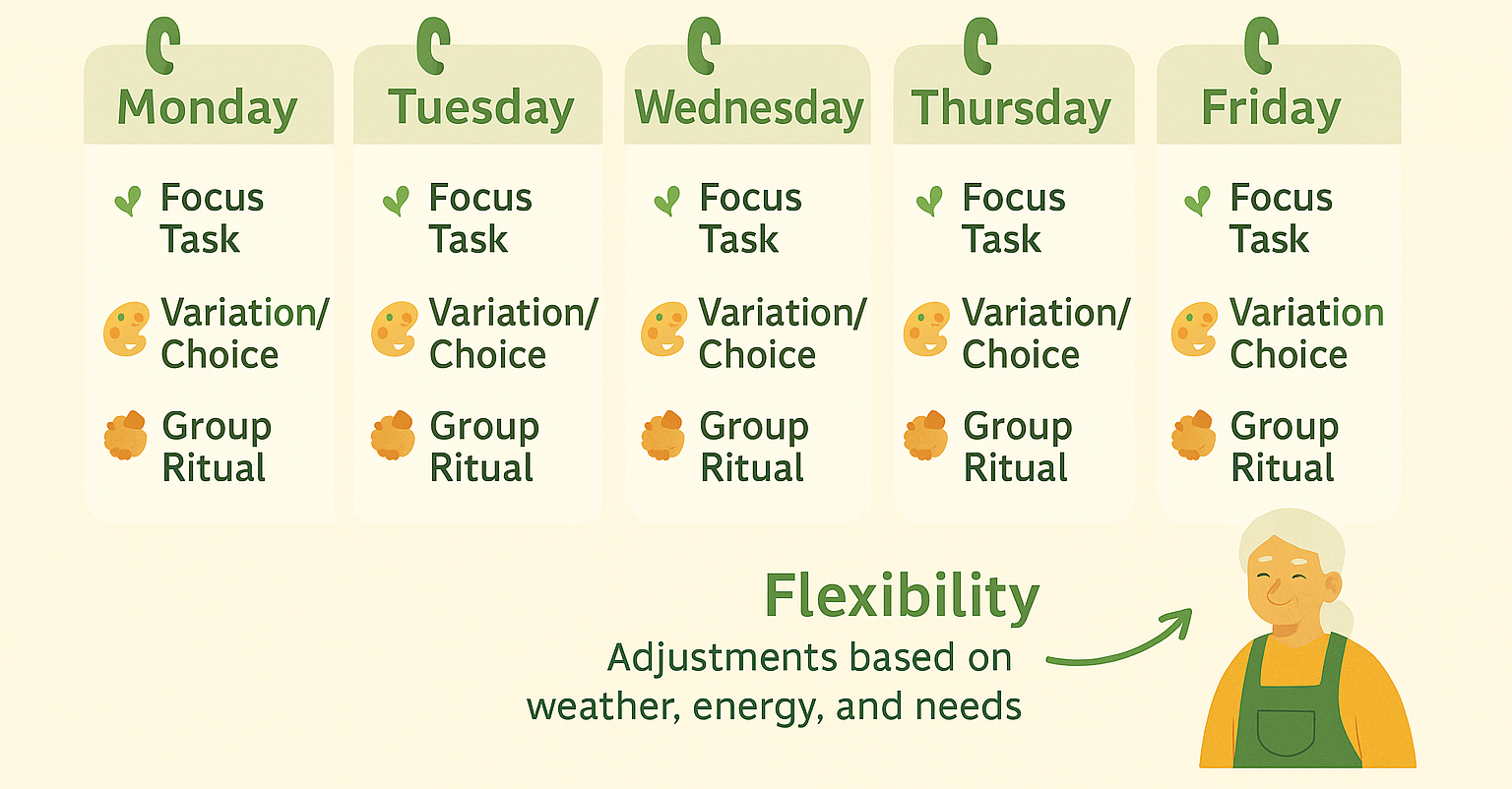
Weekly Plan
A weekly plan provides structure across several days while leaving space for flexibility. Predictability gives participants a sense of safety, while flexibility allows mentors to adapt tasks to weather, energy levels and individual needs. Small variations keep tasks engaging and regular group rituals create a sense of belonging and shared identity on the farm.
A weekly plan balances structure and flexibility – it offers stability for participants, adaptability for mentors and rituals that strengthen community.

Slide 12
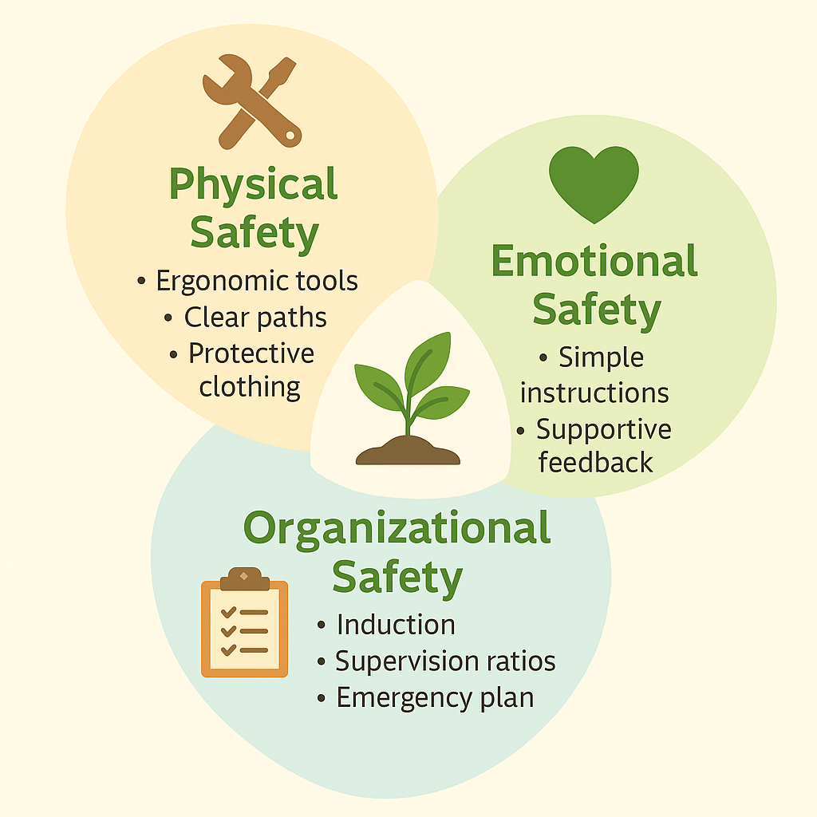
Risk Management: 3 Layers
Risk management on a social farm is not about removing all challenges but about making work meaningful and safe. Vulnerable groups may face physical limits, emotional stress or confusion in new environments. By addressing these risks on three levels – physical, emotional and organizational – farms create a secure and supportive space where everyone can contribute without fear.
Safety is the foundation of inclusion – when risks are managed well, participants feel confident, families trust the farm and mentors can focus on guidance instead of emergencies.

Slide 13
Exercise: Think and Adapt
Choose one current farm task.
Adapt it for:
  Low endurance
  Short attention
  No farm experience
Discuss in pairs:
  What stays the same?
  What changes?
With this exercise, participants put into practice the core ideas of Lesson 1. They learned how to:
observe and assess different needs and abilities;
adapt real farm tasks into manageable steps;
match participants to suitable roles;
design clear routines and visual instructions;
ensure safety through thoughtful adjustments.
This task brings together the main directions of Lesson 1 – creating inclusive, safe and meaningful farm work where everyone can contribute and grow.

Slide 14
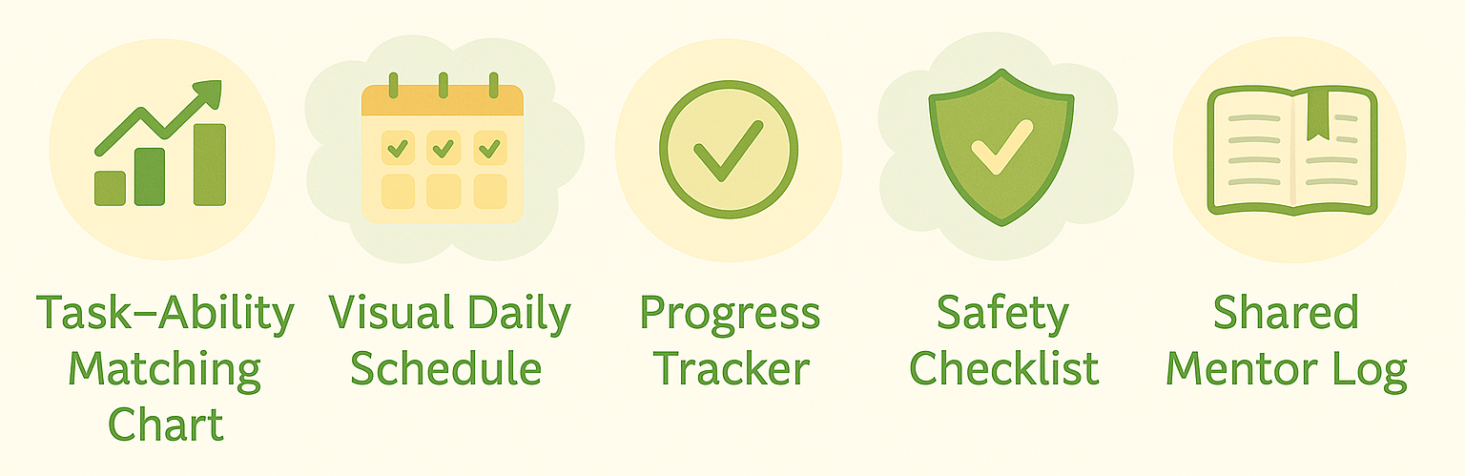
Tools You Can Use Tomorrow
Adapting farm tasks becomes easier when we have simple, practical tools at hand. These tools help mentors stay organized, support participants with clarity and make progress visible. They are ready-to-use and can be adjusted to fit any farm context.
With the right tools inclusion is not complicated – it becomes part of everyday farm life making work safer, clearer and more motivating for everyone.

