Slide 1


Slide 2

Lesson 2:
Developing Inclusive Work Environments

Slide 3
Principles of Inclusion on Farms
Inclusion goes beyond physical access → it means full participation and respect.
A truly inclusive farm:
  Welcomes people of different ages, abilities and backgrounds.
  Creates conditions where everyone can thrive.
Key aim: design spaces, processes and relationships that reduce barriers and promote equal contribution.
Inclusive farms build trust with families, social workers and communities → ensuring sustainability.

Slide 4
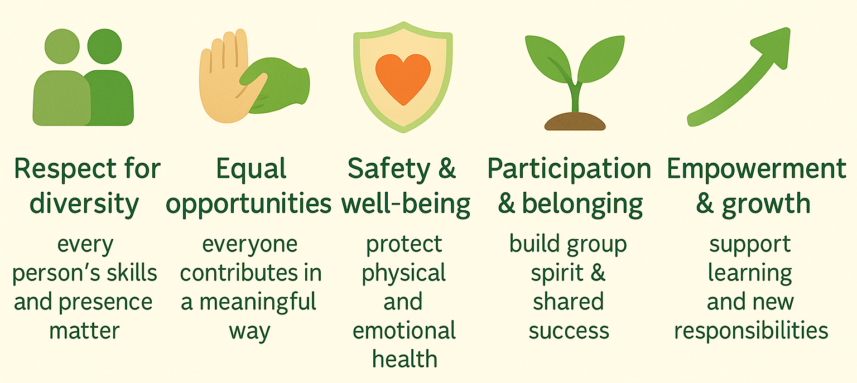
Core Principles of Inclusion
Inclusion on farms means much more than physical access — it is about creating a safe, respectful and empowering environment where everyone, regardless of ability or background, can meaningfully contribute, feel a sense of belonging and grow through shared participation.

Slide 5
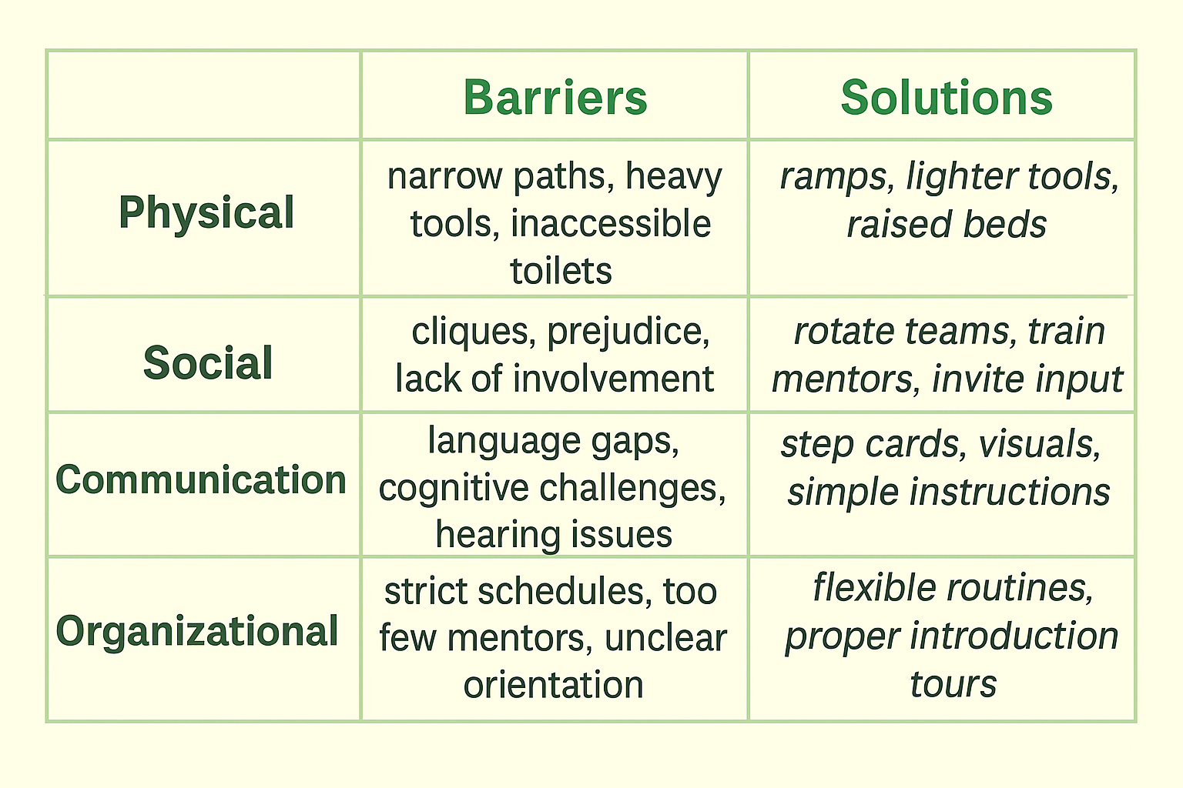
Types of Barriers on Farms
Barriers often invisible to those who feel comfortable.

Slide 6
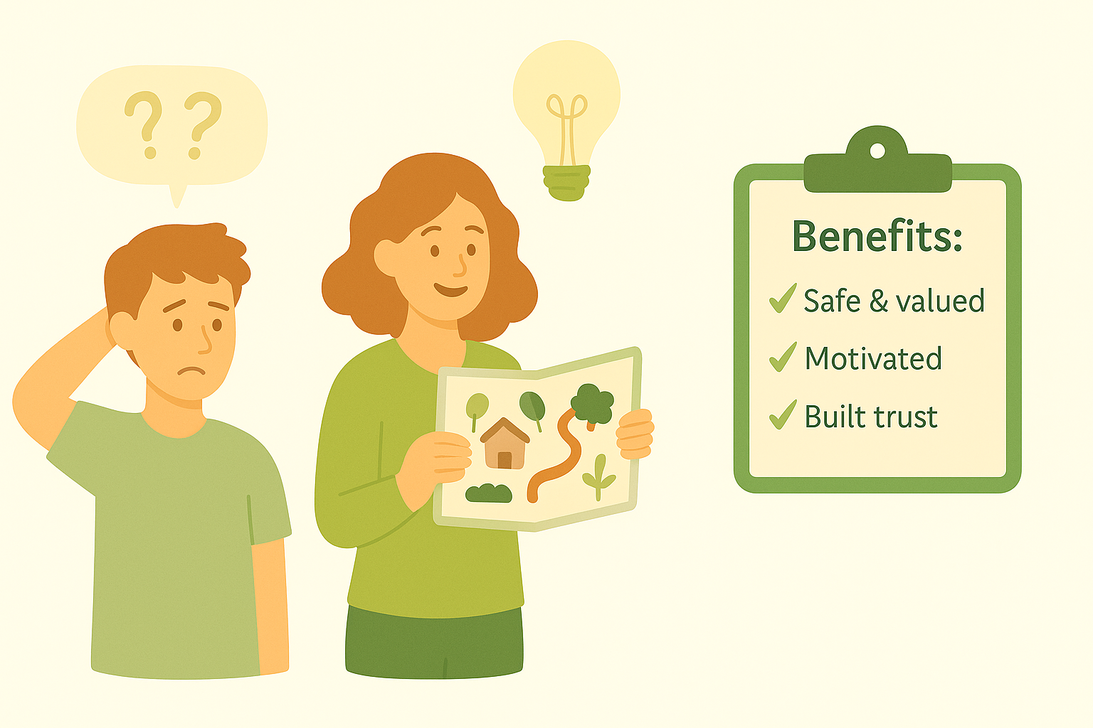
Removing Barriers: Strategies & Benefits
Practical example:
A newcomer avoids confusion when given a short orientation tour + visual farm map.
Be proactive: observe, listen, involve participants in problem-solving.
Quick wins first: lighter tools, clearer instructions, visual aids.
Systematic approach: review regularly as groups and needs change.
Shared responsibility: ask “What would make this easier for you?”

Slide 7
Participation: Creating Opportunities
Inclusion is incomplete without active involvement.
Farms can encourage participation through:
Shared decision-making – e.g. vote on crops or market layout.
Ownership of tasks – responsibility for greenhouse or compost.
Visibility of contributions – see the results of one’s own work.
Opportunities to teach others – experienced participants guide newcomers.
Practical example:
A group plants seedlings → later they share a meal from those vegetables → clear link between effort & reward.

Slide 8
Belonging: Building Community
Belonging = emotional outcome of participation.
Strengthened by daily, consistent practices:
Group rituals – greeting circle, reflection at end of day.
Shared meals & breaks – equality at the same table.
Celebrations – harvest festivals, birthdays, milestones.
Storytelling & cultural sharing – diversity as a strength.
Overcoming barriers:
Gradual integration, peer mentoring, safe spaces for communication.
Fight stigma through education & mentor role modelling.

Slide 9
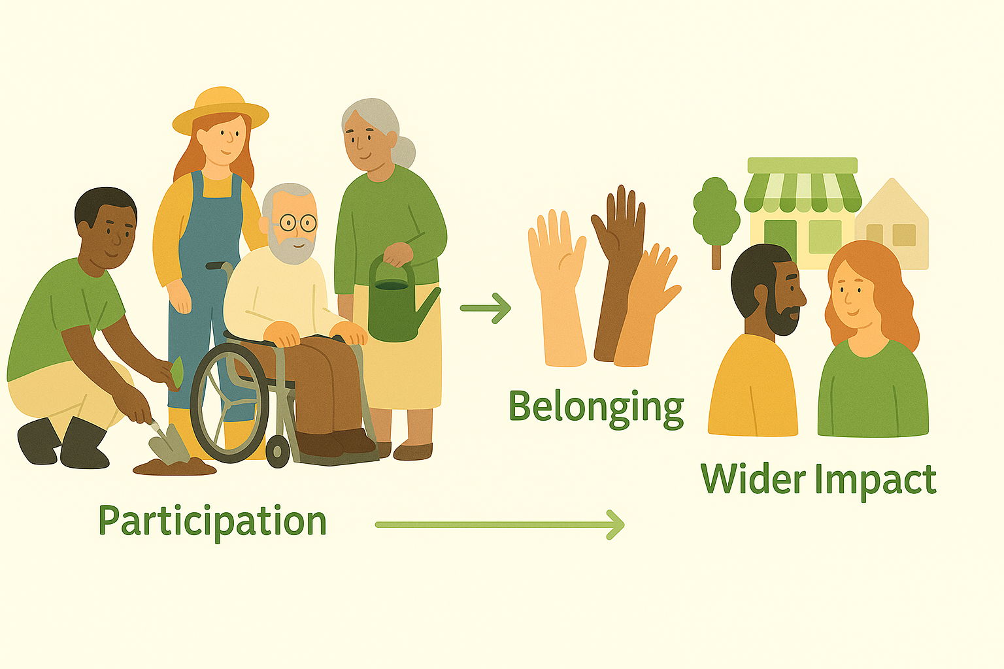
Wider Impact & Benefits
Benefits:
Motivation ↑, drop-out ↓.
Improved mental health & resilience.
Stronger community recognition & funding opportunities.
Mentors are central – listen, recognise progress, balance group dynamics.
Wider community involvement builds dignity:
Open farm days & local markets;
Schools visiting and learning from participants;
Families & neighbours joining activities.
Practical example:
A participant demonstrates farm tasks to school visitors → confidence grows & stigma decreases.

Slide 10
Why Team Building Matters
Farming = cooperation → teamwork improves productivity and inclusion.
Many participants have little/no positive teamwork experience.
Benefits of teamwork:
Social learning & communication skills.
Confidence & resilience through shared success.
Reduced mentor stress → participants rely on each other.
Practical example: Dividing a planting field into small groups → every participant contributes without being overwhelmed.

Slide 11
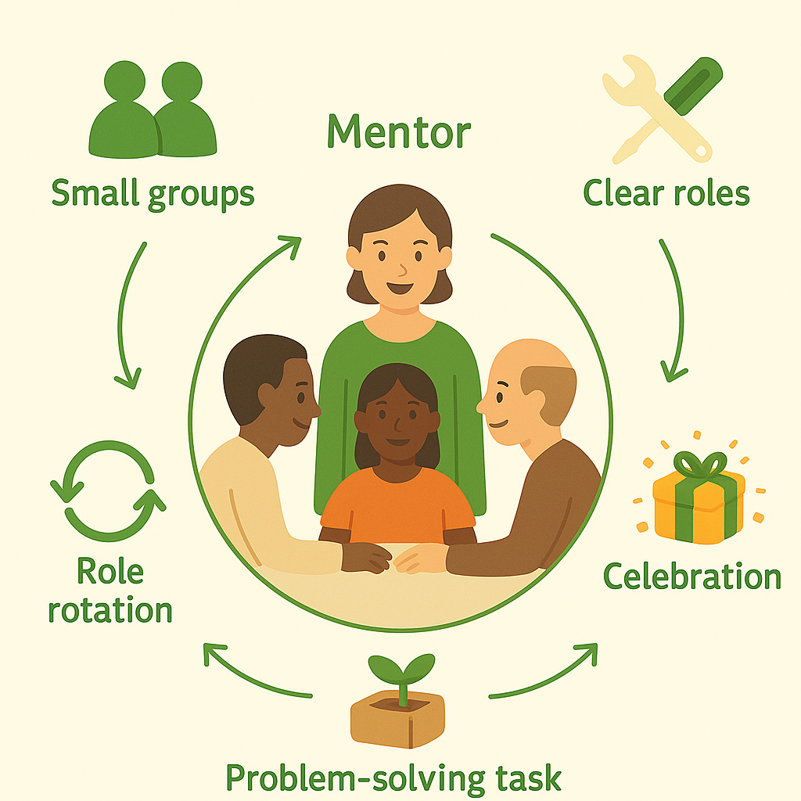
Strategies for Strong Teams
Small groups: easier participation, less anxiety.
Clear role division: avoids confusion, gives ownership.
Rotation of roles: builds flexibility, prevents monotony.
Problem-solving tasks: compost system, farm stand planning → trust grows.
Celebrating group achievements: shared meal, group photo, words of appreciation.

Slide 12
Handling Challenges: Mentor’s Role in Challenges
Conflicts happen → mentors guide constructive resolution.
Role of mentor:
Sets the tone: respectful communication, calm leadership.
Observes dynamics: supports quieter voices, manages dominant personalities.
Builds trust: keeps promises, models inclusion.
Long-term mentor impact:
Trust & stability in group.
• Continuous improvement through reflection.
• Creates safe, resilient farm culture.
Conflict resolution tools:
• Early intervention before escalation.
• Focus on behaviour, not personality.
• Encourage compromise & active listening.
Encourage inclusion: ask quieter participants for input, rotate leadership.

Slide 13
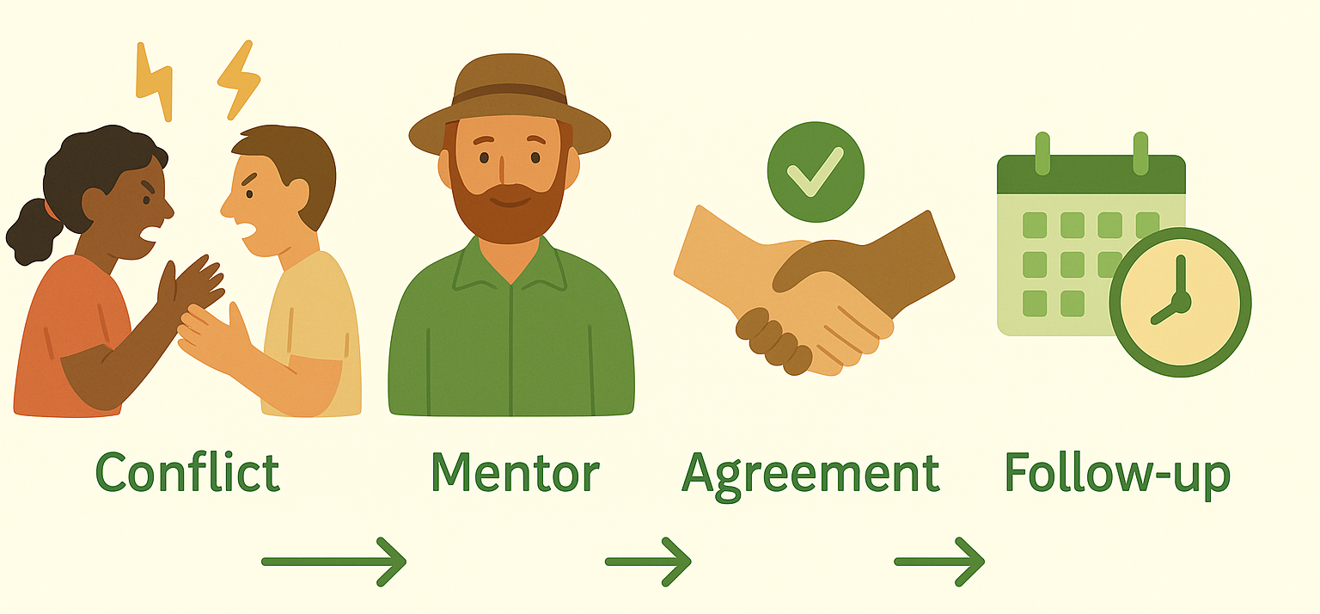
Conflict Resolution on Farms:
Resolving Conflicts Constructively
Conflicts are natural → especially in diverse/vulnerable groups.
Main sources:
  Task disagreements (speed vs. precision).
  Role confusion (dominating vs. overlooked).
  Personality clashes, stress, fatigue.
Mentor’s role:
  Intervene early, prevent escalation.
  Encourage active listening and respectful dialogue.
  Focus on behaviour, not personality.
  Guide towards compromise & shared solutions.
Practical example: Two participants argue about tool use → mentor clarifies roles calmly, encourages them to find middle ground.

Slide 14
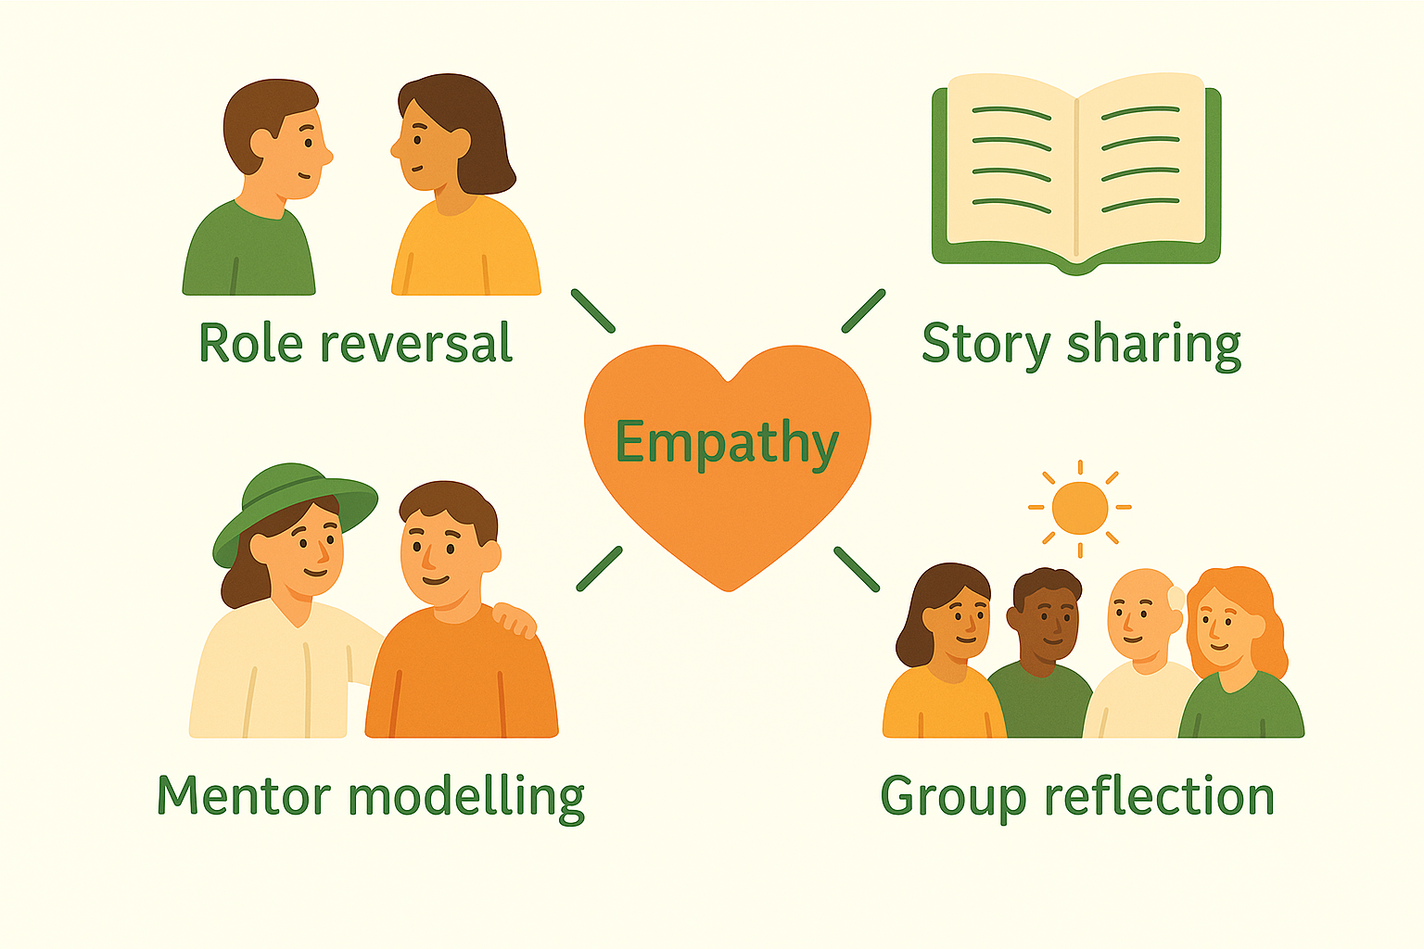
Building a Culture of Empathy
Empathy = foundation of conflict prevention and resolution.
Strategies:
  Role reversal exercises – “How would you feel?”
  Story sharing – personal experiences reduce stigma.
  Mentor modelling – respect, patience, apologising when needed.
  Daily group reflection – highlight positive actions by others.
Long-term impact:
  Trust ↑, cooperation ↑.
  Stigma ↓, group safety ↑.
  More positive working environment for mentors and participants.
Practical example: At end of day, participants share one positive thing another person did → builds appreciation and recognition of empathy.

Slide 15
International & European Models of Inclusion
Kerry Social Farming (Ireland): ordinary farm life, adapted tasks, reflection circles → inclusion rooted in everyday routines.
IPS Model (EU): focus on strengths + close mentorship, mediation turns conflicts into growth.
Italy – Social Cooperatives: farming + social services, team-based tasks, strong peer support.
Slovenia – Korenika: multigenerational centre with food production, workshops, therapeutic gardens, seed preservation.
Netherlands – Care Farms: elderly & dementia care, therapeutic gardening, structured routines.
Different contexts, same goal → dignity, belonging and participation for vulnerable groups.

Slide 16
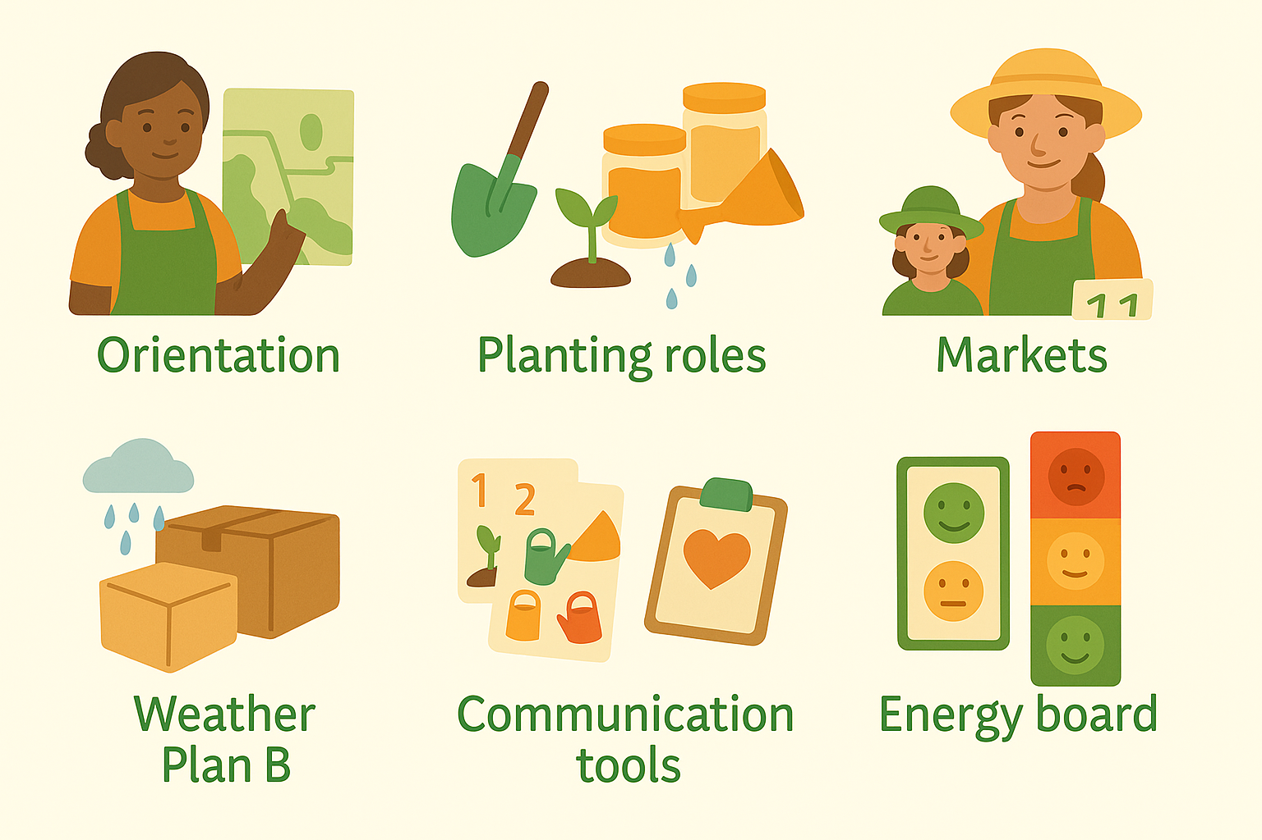
Practical Solutions on Farms
Structured entry: orientation tour + easy starter tasks → builds confidence.
Planting tasks: divide into roles + rotate → prevent monotony, support different abilities.
Packaging lines: U-shaped tables, micro-roles, visual samples → everyone contributes.
Markets: greeter/bagger/stocker roles, price boards, quiet corner → reduce stress.
Weather flexibility: indoor “plan B” ensures stability and routine.
Communication-friendly: step cards, colour-coded tools, demo + practice.
Trauma-informed: predictable routines, choice of tasks, non-verbal break signals.
Energy check system: red-yellow-green signals → adapt workload to wellbeing.
Debriefing: after incidents → learning, trust, recognition.

Slide 17
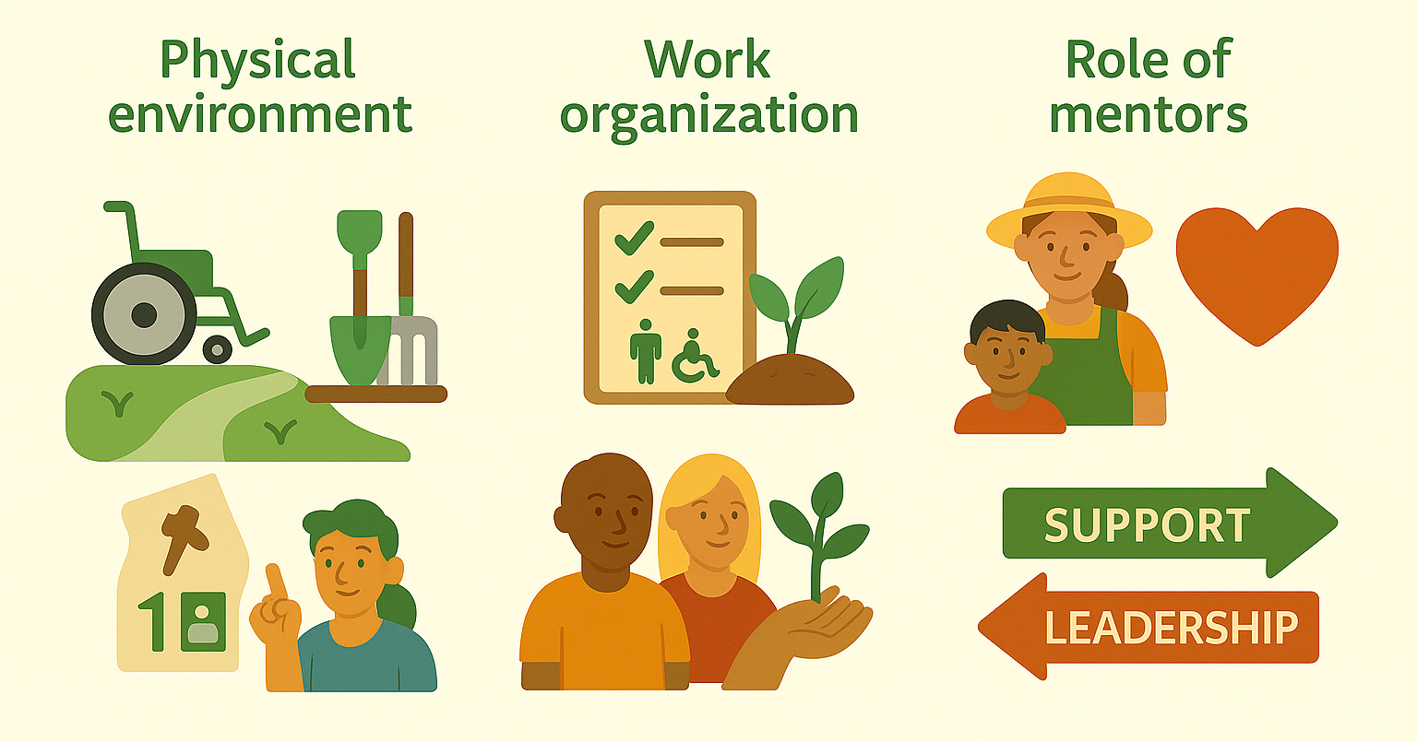
Practical Guidelines for Inclusive Farms:
From Theory to Daily Practice
Role of mentors:
Not only supervisors, but backbone of inclusion.
Flexibility, patience, balance between leading & supporting.
Physical environment:
Accessible paths, ramps, reachable tools, clear signage.
Organised spaces reduce stress & confusion.
Work organisation:
Defined roles = predictability & security.
Tasks adapted to abilities, step-by-step approach.
Visible contribution builds confidence.

Slide 18
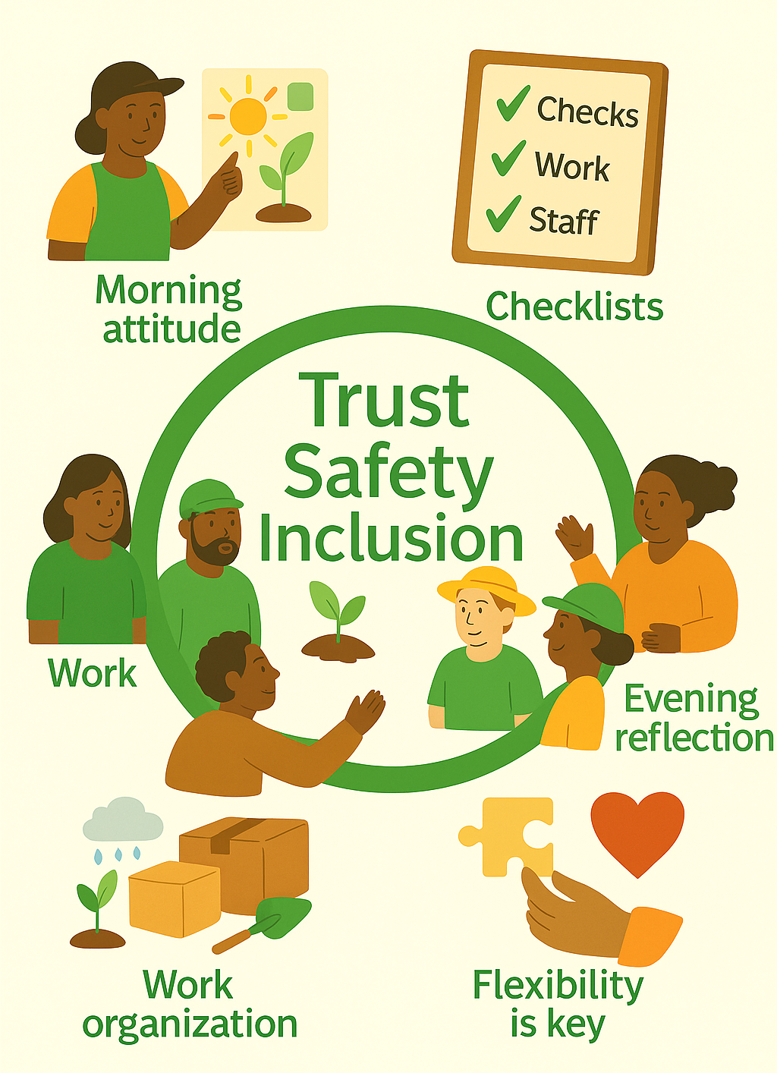
Routines & Tools for Stability
Daily routines:
Morning intro = clarity.
Evening reflection = recognition & support.
Consistency → trust & safety.
Checklists as tools:
Space – accessible paths, labelled tools, rest areas.
Work organisation – clear roles, adapted tasks, breaks.
Staff – trained mentors, peer exchange, crisis protocols.
Flexibility is key:
structure guides, empathy makes it work

Slide 19
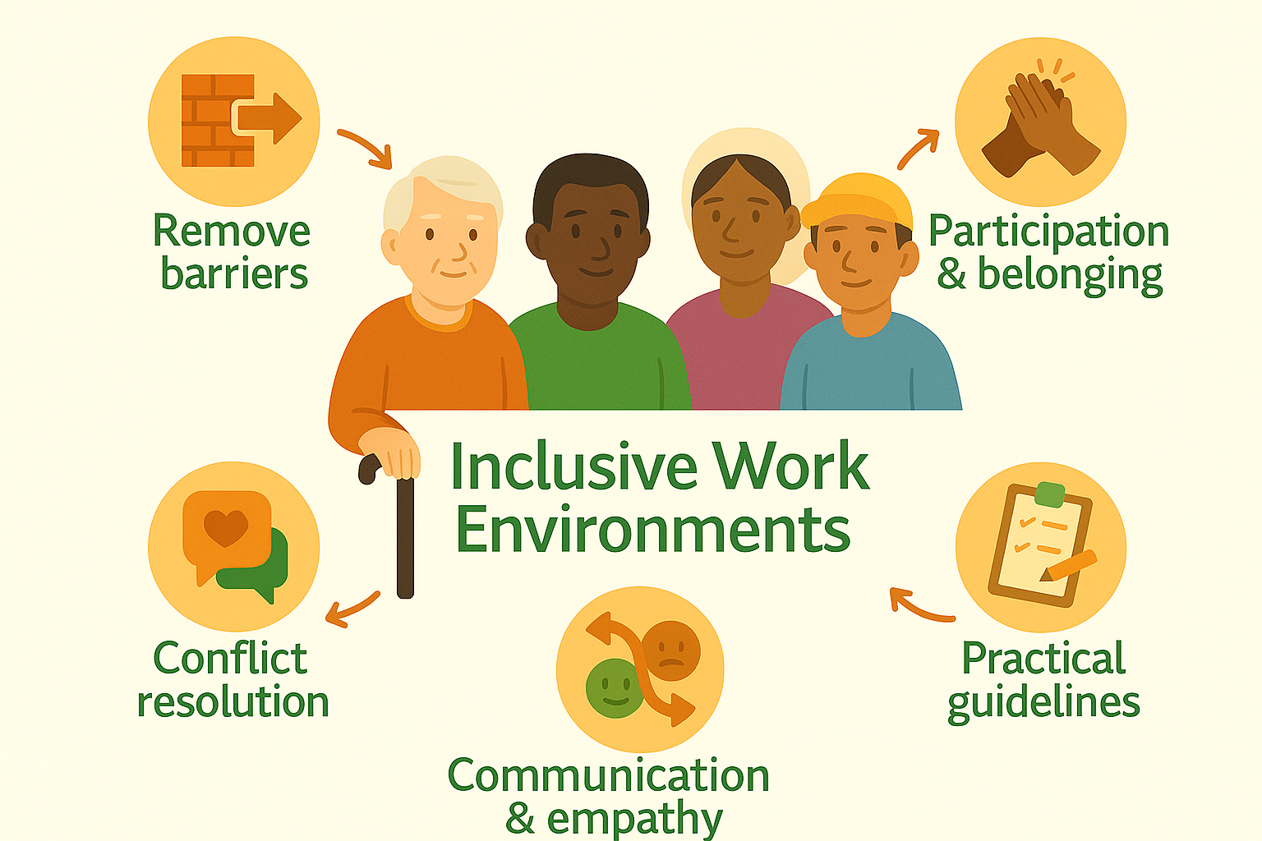
Key Lessons from Lesson 2
Inclusion = beyond access → respect, participation, belonging.
Barriers must be identified & removed → physical, social, communication, organisational.
Participation + belonging = confidence, stability & resilience.
Team building strengthens productivity and unity → mentor plays central role.
Conflict resolution & empathy transform problems into opportunities.
Examples from practice show that small adaptations create big impact.
Practical guidelines (routines + checklists) provide safety, dignity & growth.

