Slide 1


Slide 2

Lesson 3:
Training and Mentoring Approaches

Slide 3
Training and Mentoring Approaches
Social farming needs more than farming skills – it requires guidance, support and empowerment of vulnerable participants.
Mentoring is at the heart of inclusive and sustainable farm environments.
Mentors are not supervisors but facilitators of learning and inclusion.
Through empathy, encouragement and guidance, everyday farm tasks become opportunities for growth.
This lesson combines theory and practice to show how mentoring builds confidence, independence and belonging.

Slide 4
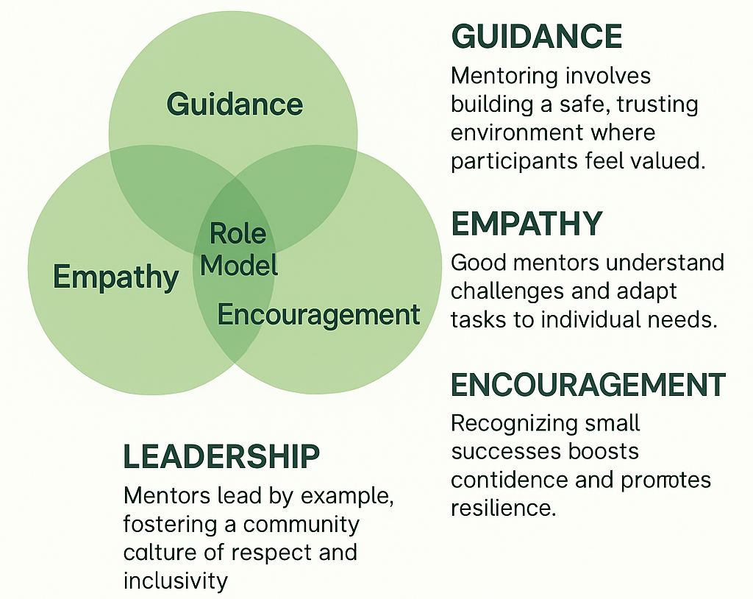
Role of Mentors in Social Farming
Cornerstone of inclusion: Mentors link farm work with the mission of empowering vulnerable groups.
Lead through empathy & encouragement: Not authority or control.
Role models: Patience, respect and consistency create safety and belonging.
See the person, not only the task: Understand hidden challenges (anxiety, trauma, low self-confidence).
Balance: Provide structure without overprotection, freedom without neglect.

Slide 5
Listening & Giving Instructions:
Everyday Mentoring in Action
Active Listening
Participant avoids eye contact and gives short answers → Mentor asks: “Would you like me to explain again?”
During seed planting: “Can you show me with your hands how deep we should place the seed?”
Clear Instructions
Instead of “Prepare the garden bed” → 4 steps: bring tools → remove weeds → smooth soil → mark rows.
Color-coding: green watering can = indoor plants, blue = outdoor.
Mentor demonstrates slowly: “I place the seedling → cover with soil → press gently → water once.” Participant repeats.

Slide 6
Feedback & Everyday Problem-Solving:
Turning Barriers into Opportunities
Constructive Feedback
  “I see you planted in straight rows – well done.”
  “The soil was pressed too hard, let’s try more gently together.”
  Sandwich method: “You focused really well → try spacing plants a bit more → I know you can do it.”
Practical Everyday Solutions
  Low focus → 10-minute tasks + visual timer.
  Anxiety with tools → start with small hand tool.
  Memory support → laminated step-by-step cards at workstation.
  Low endurance → alternate heavy and light roles (weeding ↔ labeling jars).
  Safe failure → practice planting in tray before moving to the field.

Slide 7
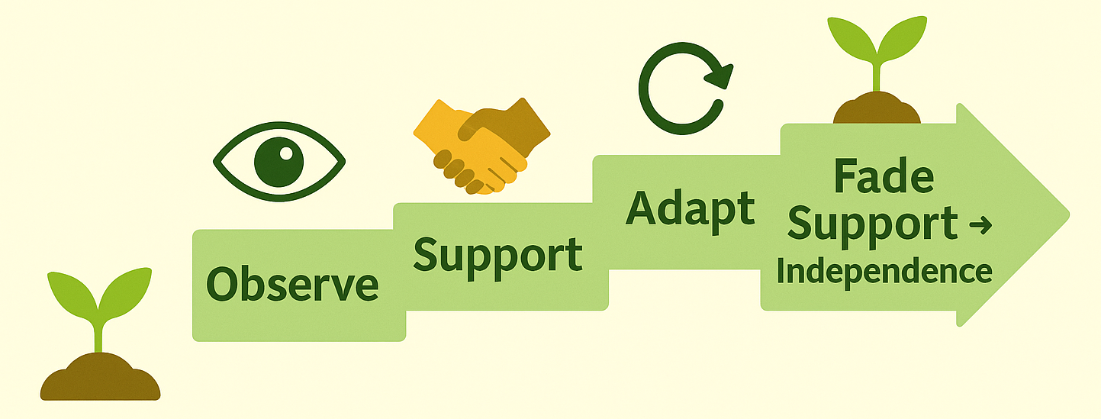
What is Job Coaching?
Job Coaching on Social Farms
Focused on task performance & building work habits.
Goal: guide step by step until participants work independently.
Role of job coach:
observe → support → adapt → fade support.
Builds confidence, autonomy and resilience.

Slide 8
Core Principles & Practical Approaches
Practical Approaches:
Task breakdown: e.g. lettuce harvest = select → loosen → cut → wash → crate.
Visual supports: step cards/icons for planting.
Prompting & fading: demo → verbal → visual → independence.
Positive reinforcement: “You harvested 3 heads today—improvement from yesterday!”
Problem-solving together: “What do you think happened here?”
Principles:
Individualised support
Step-by-step skill development
Hands-on learning
Encouragement of independence
Consistency & predictability

Slide 9
Challenges, Solutions & Exercise
Common Challenges & Solutions:
Slow pace → adjust, repeat in short sessions, celebrate small wins.
Resistance/anxiety → start with low-risk tasks, build gradually.
Inconsistent performance → maintain routine, adapt tasks to energy.
Communication barriers → gestures, demos, simple visuals.
Practical Examples:
      Selling products at market → coach models greetings → fades support.
      Packaging boxes → break into stages, reduce supervision over time.
      Weeding → marked row, breaks, check-ins → longer focus achieved.

Slide 10
Why Ongoing Support Matters:
Sustaining Inclusion and Empowerment
Mentoring continues after tasks are learned.
Ensures growth, motivation and belonging over time.
Not constant supervision → but systems of stability & encouragement.
Protects dignity: adapts to health, motivation and energy changes.
Examples:
Tired participant → lighter task (sorting, labeling, preparing tools).
Outdoor work canceled → indoor alternative (seed sorting, packaging).

Slide 11
Key Strategies in Practice:
From Feedback to Flexibility
Regular feedback → balanced correction + recognition of effort.
Reflection sessions → daily/weekly sharing of achievements & struggles.
Peer support → newcomers paired with experienced participants.
Consistent routines + flexibility → structure with adaptable alternatives.
Crisis response → supportive debriefs:
what happened → one improvement → recognition of support.
Examples:
Friday reflection circle → feedback adjusts next week’s roles.
Younger participant helps older with tools → teamwork & pride.
Conflict resolved → group agrees on clearer signals.

Slide 12
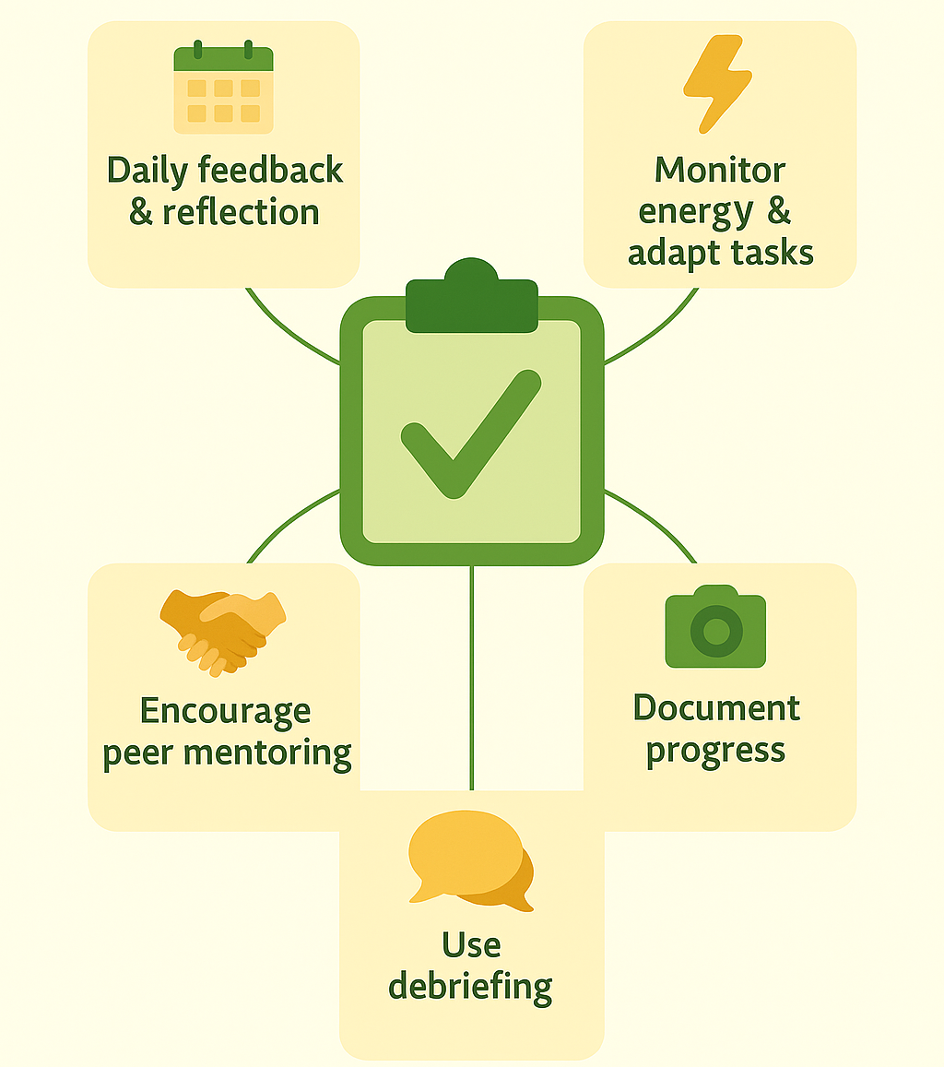
Practical Tools:
Designing Ongoing Support Plans
Daily feedback & reflection routines.
Monitor energy & adapt tasks promptly.
Encourage peer mentoring.
Document progress (checklists, photos, charts).
Use debriefing to rebuild trust.

Slide 13
Productivity & Learning:
A Delicate Balance
Guidelines:
View productivity as both output + social growth.
Match tasks to abilities (slower + skilled roles together).
Use production tasks as teaching opportunities.
Clarify which tasks need precision vs. which allow practice.
Celebrate yields and learning milestones equally.
Farms = economic units + learning environments.
Too much focus on productivity → pressure & exclusion.
Too much focus on learning → loss of efficiency & sustainability.
Balance = both goals reinforce each other.
Productivity includes social value: confidence, skills, belonging.

Slide 14
Learning While Producing
Examples:
Preparing vegetables for market → experienced weigh & clean, newcomers label.
Bread making → one kneads slowly (practice), another keeps schedule.
Orchard → faster workers harvest, learners sort by size/quality.
Packaging herbs → newcomers practice sealing, experienced check stock & quality.

Slide 15
Principles & Approaches:
Mentoring Vulnerable Groups
Core principles:
See the person, not the difficulty → focus on abilities, interests, and potential.
Adaptation without overprotection → support + freedom to try, fail, and learn.
Predictable routines → reduce anxiety, increase stability.
Feedback with recognition → highlight effort and progress.
Respect & dignity → patience in every interaction.

Slide 16
Mentoring Vulnerable Groups:
Approaches & Examples
Group / Challenge | Approach | Practical Example
🧑‍🦽 Physical disabilities | Adapted tools, raised beds, clear pathways | Limited mobility → raised bed + lightweight watering can → independence
🧠 Mental health difficulties | Calm routines, encouragement on low days | Depression → warm greeting + small task list → gradual engagement
👵 Elderly | Shorter tasks, rest opportunities, value life experience | Older adult → garden work + labeling jars → balanced activity
👩‍🎓 Youth at risk | Clear rules, visible success in small steps | Teenager with low focus → 3-step tasks + immediate feedback → completion celebrated
🌍 Migrants / language barriers | Visual instructions, peer support | Language barrier → picture-based composting guide → independent practice

Slide 17
Good Practice Examples in Social Farm Mentoring
Approach | Description | Key Benefit
🌱 Rotational Learning Circles | Participants rotate roles (planting, watering, harvesting). | Prevents boredom, reveals strengths.
📖 Story-Based Skill Training | Instructions embedded in simple stories (e.g., animal feeding as a daily story). | Easier recall, builds pride in repetition.
🤝 Peer Shadowing | Newcomer paired with an experienced participant. | Builds skills and empowers both individuals.
🧘 Quiet Zone Workspaces | Designated calm spaces for focused tasks. | Reduces anxiety while keeping participants included.
✍️ Success Journals | Participants record achievements with drawings, notes or photos. | Creates visible progress, strengthens confidence.

Slide 18
Good Practice Examples in Social Farm Mentoring
Approach | Description | Key Benefit
💡 Group Problem-Solving | Challenges turned into collective brainstorming and solution testing. | Fosters teamwork and values participants’ opinions.
🔧 Inclusive Tool Design | Tools adapted for easier handling (lightweight watering cans, soft handles). | Enables participation for those with physical barriers.
🎉 Celebrating Micro-Achievements | Weekly recognition of small victories (e.g., finishing a row, speaking up). | Weekly recognition of small victories (e.g., finishing a row, speaking up).
🪑 Buddy Bench | A bench signals that someone needs support; peers/mentors offer conversation. | Encourages healthy communication, reduces anxiety.
🛒 Market Simulation Training | Practice market setup and sales in a safe environment before real markets. | Increases confidence, prepares for real social settings.

Slide 19
Practical Mentoring Toolkit:
Everyday Tools for Inclusive Guidance
Category | Tools & Methods | Practical Examples
👀 Visual Support Tools | Step-by-step picture cards, laminated posters, colour-coded tools, checklists | Participant with limited literacy uses a laminated checklist → ticks tasks off daily.
🗣 Communication & Feedback | Feelings board (😊 😐 ☹), “Two stars & a wish” method | Mentor uses two positive comments + one suggestion → feedback stays balanced.
🔄 Routines & Reflection | Morning briefing with visuals, daily reflection circles, progress folders | End-of-week reflection board → sticky notes under “I enjoyed / I learned / I found difficult.”
🤝 Peer Support Tools | Buddy system, shared problem-solving board | New participant paired with a buddy → learns tasks and feels included.
🐾 Applied Visuals in Tasks | Pocket-sized instruction cards | During animal care → pocket card with feeding steps ensures accuracy & independence.

Slide 20
Key Messages from Lesson 3
Mentoring in Social Farming means:
Empathy + Encouragement + Guidance → safe, inclusive environment.
Practical skills (listening, clear instructions, feedback) make daily tasks learning opportunities.
Job coaching builds confidence through step-by-step support and gradual independence.
Ongoing strategies (feedback, reflection, flexibility, peer mentoring) sustain motivation and belonging.
Balance productivity with learning → both economic results and social value matter.
Tailored mentoring ensures every vulnerable group can contribute and grow.
Good practices & toolkit turn theory into practical, everyday tools.

